Slide 1
Introduction to Platform Administrative Web Service Interface
June 2012

Slide 2
Agenda
What is PAWS?
Getting Started with PAWS
Typical Use Cases
Resources
Result Codes & Error Handling
Coding Examples
Sample Application Demo
Wrap Up

Slide 3
What is PAWS?

Slide 4
Platform Administrative Web Service
Executive Summary
New “upgrade orchestration features”
  PAWS-Interface: developer-ready Cisco UC software version management interface
  PAWS-Management: Cisco branded “console” application that uses PAWS-I
Value / Strategic Fit:
  Address key customer use cases
    “Multi-cluster upgrade” for large multi-site-distributed deployments
    “Cluster-based upgrade” for super-clusters
    “Upgrade Orchestration” to reduce complexity
  Reduce upgrade hassles – lower upgrade costs, risk, and travel requirements
Cisco or
CDN partner utility/console talking to PAWS API
PAWS
…
…
CUCM Nodes
“CUP” Nodes
…
SME Nodes

Slide 5


Platform Administrative Web Service
Allows applications to initiate and monitor upgrades on multiple UC Clusters from a single management client via the PAWS-I API
Facilitates large scale deployments/upgrades
New public interface in Unified CM 9.0(1)
XML/SOAP based on AXIS 2.0
WSDL in doc/literal format which aligns with the Unified CM Administrative and Service XML interfaces as well as the UC Gateway Services interface
Native support for Visual Studio 2010 & .Net v2/3/4

Slide 6
Platform SOAP Services allow you to:
Inspect & Inventory
  Hardware Model, Active/Inactive Version, and Install Options
  Installed Products
      Unified Communication Manager (CUCM)
      IM/Presence Services (IM/Presence)
      Session Manager Enterprise (SME)
  Upgrade State (error, cancelled, downloading, installing, etc)
Upgrade
  Test install/upgrade file for validity
  Filter a list of install/upgrade files
  Prepare Upgrade (Download Upgrade Files)
  Start Upgrade
Switch Version / Restart Server

Slide 7
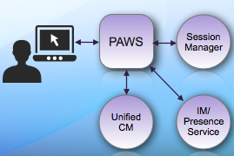
PAWS Supported Applications

Slide 8
PAWS-Management
Solution Bundle
Cisco's web-based application which uses the PAWS Interface
Centralizes inventory & version management of Cisco UC
Supports Session Manager Enterprise, Unified CM, and IM/Presence Service
  Additional UC applications will be supported in a future release
PAWS-Management (PAWS-M) will be bundled with Hosted versions of Unified CM Enterprise, Session Manager Enterprise, and IM/Presence Services in our 9.0(1) release
PAWS-M is bundled with Hosted UC in 8.6(1)

Slide 9
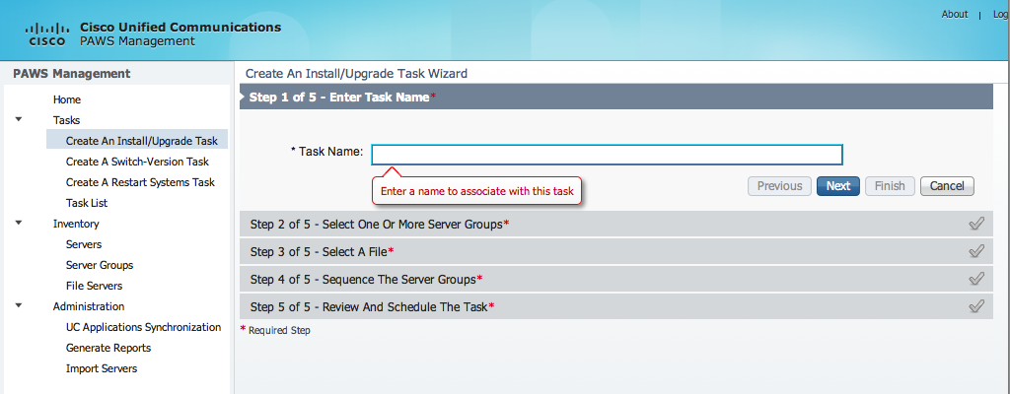
PAWS-Management
Login using the ‘Platform Administrator’ account created during installation

Slide 10
Additional Information
PAWS will be a public interface in the UC 9.0(1) release
Enables Cisco UC software version management to be integrated with third-party Serviceability consoles
New Developer Portal
  http://developer.cisco.com/web/paws-developer
  Launch June 2012
  Developer Guide & API Reference
  Resources used for a typical upgrade
  Request/Response code examples
  Sample application
  Discussion Forums

Slide 11
Exploding Some PAWS Myths
Does not reduce elapsed time to “write the bits”
  Minor time savings from task concurrency if you sequence tasks correctly
Does not do platform migrations
  e.g. MCS to MCS, MCS to UCS, UCS to UCS
Does not handle IP address or hostname changes
Does not auto-poll or download upgrade files from cisco.com
Does not auto-distribute upgrade files to app nodes
Does not auto-update … programming has to be “started”; then the PAWS-enabled application automates it

Slide 12
Getting Started with PAWS

Slide 13
Platform Administrative Web Services
Enable the PAWS Service
By default, the PAWS service is disabled
  Must be activated and running before use
Option 1: Activate from Serviceability GUI
  Listed under Database and Admin Services
  PAWS service can be activated, started and stopped
Option 2: Activate from the Command Line Interface (CLI)
  utils service activate Platform Administrative Web Service
  utils service deactivate Platform Administrative Web Service
  To start and stop an already activated PAWS service from the CLI:
    utils service start Platform Administrative Web Service
    utils service stop Platform Administrative Web Service

Slide 14
Platform Administrative Web Services
Enable the PAWS Service
Option 3: Activate from Service XML interface
  Refer to ControlCenterServices API
  soapDoControlServices operation takes one array of service names for which their services are either started or stopped
  xmlns:ns2="http://cisco.com/ccm/serviceability/soap/ControlCenterServices/">
  <NodeName xsi:type="xsd:string" xsi:nil="true"/>
  <ControlType href="#id1"/>
  <ServiceList xsi:type="soapenc:Array" soapenc:arrayType="xsd:string[1]">
  <item>Platform Administrative Web Service</item>
  </ServiceList>
  </multiRef>
  <multiRef id="id1" soapenc:root="0"
  soapenv:encodingStyle="http://schemas.xmlsoap.org/soap/encoding/"
  xsi:type="ns3:ControlType"
  xmlns:ns3="http://cisco.com/ccm/serviceability/soap/ControlCenterServices/"
  xmlns:soapenc="http://schemas.xmlsoap.org/soap/encoding/">Start</multiRef>

Slide 15
Activating the PAWS Service

Slide 16
Platform Administrative Web Services
Access the PAWS Service Web Portal
Mechanism to verify PAWS Service is running
All interaction with PAWS Service requires authentication
  Must have an OS Administrator (CMPlatform Realm) Account
  Can use the account created during installation
  Can use the CLI to create a new account for PAWS Administration
Check CLI Reference Guide for Unified CM for more info
Create Account via CLI
admin:set account name pawsadmin
Privilege Levels are:
Ordinary - Level 0
Advanced - Level 1
Please enter the privilege level :0
Please enter the password :*******
re-enter to confirm :*******
Account successfully created

Slide 17
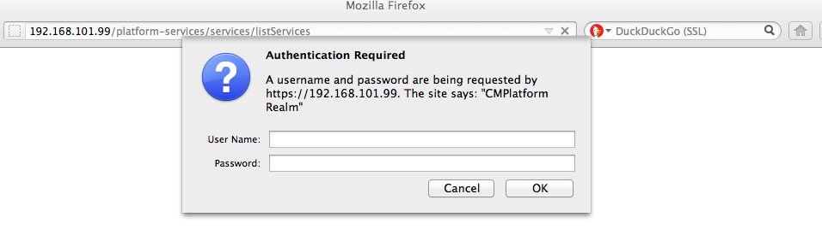
Access the list of PAWS Services
Make sure PAWS Service is running
Access to Service List requires authentication via Platform Administrator credentials
Display available services via:
https://<server>/platform-services/services/listServices

Slide 18
Platform Administrative Web Service
Available Services and Access to the WSDL
Request WSDL for client stub generation
  https://<server>/platform-services/services/<Service Name>?wsdl
Call a service
  https://<server>/platform-services/services/<Service Name>

Slide 19
Interacting with the PAWS Service
Support for Synchronous and Asynchronous Calls
Each PAWS service can be invoked either:
  Synchronously – In a Blocking client manner
  Asynchronously – In a Non-Blocking client/server manner
Each PAWS service implements an asynchronous IN-OUT message exchange protocol (MEP)
MEP is SOAP-based and must use well-formed SOAP messages

Slide 20
Interacting with the PAWS Service
Using Synchronous Calls
Client application POSTs a request and waits for a response
Synchronous Calls
  Open a socket to requested service
  Wait for a response before closing the socket
  Can waste server resources during lengthy operations
Request can “timeout” while waiting for a response when requests take a long time to complete
  Downloading an upgrade file
  Running a server upgrade

Slide 21
Interacting with the PAWS Service
Using Asynchronous Calls
Client application POSTs a request and response is sent to a ‘callback server’
Asynchronous calls
  Do not wait for a response to close the socket
  Contain a WS-Addressing endpoint reference (reply-to URL)
  Acknowledged with HTTP 202 return code before calling desired service
Once the service completes, a response is sent to the provided endpoint
  Responses include result code, messages, and any available results
  MessageID in request is returned with the response to relate the request and response messages
Maximum of 3 concurrent requests are allowed on a given server
  Additional requests queued up to 60 seconds before being rejected
Callback server must be available or the response is lost

Slide 22
Selecting Sync vs Async Behavior
Key to selecting between Synchronous and Asynchronous behavior is the <wsa:ReplyTo> element
  <wsa:ReplyTo> request always includes <wsa:Address> of a “callback” server
Synchronous callback
  Provide the synchronous callback address:
  <wsa:Address>http://www.w3.org/2005/08/addressing/anonymous</wsa:Address>
Asynchronous callback
  Provide the address of your application’s callback server:
  <wsa:Address>http://<server>:<port>/servlet/WSACallBackHandler</wsa:Address>

Slide 23
Choosing Sync or Async Calls
Which one should you use?
Applications can use any Resource synchronously or asynchronously
  Choice depends upon application requirements and programmer comfort
Following Resources should typically be called asynchronously:
  UpgradeFilterService: upgradeFilter
  UpgradeProgressStageService: getUpgradeProgress
  CancelUpgradeService: cancelUpgrade
  PrepareUpgradeService: prepareRemoteUpgrade
  StartUpgradeService: startUpgrade

Slide 24
PAWS Service Example
APIVersionService
  Single Resource: getAPIVersion
  Can be called synchronously or asynchronously
  Good idea to validate API Version before proceeding
Currently available API Version:
  API Version 5.0.1.0 is first public version in UC Manager 9.0
Upcoming slides show the difference between using getAPIVersion synchronously and asynchronously

Slide 25
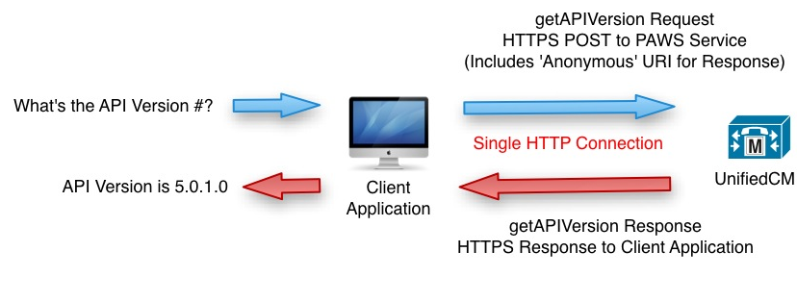
Synchronous Example of getAPIVersion
Application Interaction with PAWS Service

Slide 26
Synchronous Code Sample getAPIVersion Request
<?xml version="1.0" encoding="UTF-8"?>
<soapenv:Envelope xmlns:soapenv="http://schemas.xmlsoap.org/soap/envelope/" xmlns:xsd="http://www.w3.org/2001/XMLSchema" xmlns:xsi="http://www.w3.org/2001/XMLSchema-instance">
<soapenv:Header>
<wsa:Action xmlns:wsa="http://schemas.xmlsoap.org/ws/2004/08/addressing">urn:getAPIVersion</wsa:Action>
<wsa:MessageID xmlns:wsa="http://schemas.xmlsoap.org/ws/2004/08/addressing">uuid:63e5d8ca-dcac-40af-916b-d32ec3382d0f</wsa:MessageID>
<wsa:ReplyTo xmlns:wsa="http://schemas.xmlsoap.org/ws/2004/08/addressing">
<wsa:Address>http://www.w3.org/2005/08/addressing/anonymous</wsa:Address>
</wsa:ReplyTo>
<wsa:To xmlns:wsa="http://schemas.xmlsoap.org/ws/2004/08/addressing">https://192.168.101.99/platform-services/services/APIVersionService.APIVersionServiceHttpSoap11Endpoint</wsa:To>
</soapenv:Header>
<soapenv:Body>
<getAPIVersion xmlns="http://services.api.platform.vos.cisco.com"/>
</soapenv:Body>
</soapenv:Envelope>

Slide 27
Synchronous Code Sample getAPIVersion Request
<?xml version="1.0" encoding="UTF-8"?>
<soapenv:Envelope xmlns:soapenv="http://schemas.xmlsoap.org/soap/envelope/" xmlns:xsd="http://www.w3.org/2001/XMLSchema" xmlns:xsi="http://www.w3.org/2001/XMLSchema-instance">
<soapenv:Header>
<wsa:Action xmlns:wsa="http://schemas.xmlsoap.org/ws/2004/08/addressing">urn:getAPIVersion</wsa:Action>
<wsa:MessageID xmlns:wsa="http://schemas.xmlsoap.org/ws/2004/08/addressing">uuid:63e5d8ca-dcac-40af-916b-d32ec3382d0f</wsa:MessageID>
<wsa:ReplyTo xmlns:wsa="http://schemas.xmlsoap.org/ws/2004/08/addressing">
<wsa:Address>http://www.w3.org/2005/08/addressing/anonymous</wsa:Address>
</wsa:ReplyTo>
<wsa:To xmlns:wsa="http://schemas.xmlsoap.org/ws/2004/08/addressing">https://192.168.101.99/platform-services/services/APIVersionService.APIVersionServiceHttpSoap11Endpoint</wsa:To>
</soapenv:Header>
<soapenv:Body>
<getAPIVersion xmlns="http://services.api.platform.vos.cisco.com"/>
</soapenv:Body>
</soapenv:Envelope>
<wsa:Action xmlns:wsa="http://schemas.xmlsoap.org/ws/2004/08/addressing">
urn:getAPIVersion
</wsa:Action>
<wsa:To xmlns:wsa="http://schemas.xmlsoap.org/ws/2004/08/addressing">https://192.168.101.99/platform-services/services/APIVersionService.APIVersionServiceHttpSoap11Endpoint</wsa:To>
<soapenv:Body>
<getAPIVersion xmlns="http://services.api.platform.vos.cisco.com"/>
</soapenv:Body>

Slide 28
Synchronous Code Sample getAPIVersion Request
<?xml version="1.0" encoding="UTF-8"?>
<soapenv:Envelope xmlns:soapenv="http://schemas.xmlsoap.org/soap/envelope/" xmlns:xsd="http://www.w3.org/2001/XMLSchema" xmlns:xsi="http://www.w3.org/2001/XMLSchema-instance">
<soapenv:Header>
<wsa:Action xmlns:wsa="http://schemas.xmlsoap.org/ws/2004/08/addressing">urn:getAPIVersion</wsa:Action>
<wsa:MessageID xmlns:wsa="http://schemas.xmlsoap.org/ws/2004/08/addressing">uuid:63e5d8ca-dcac-40af-916b-d32ec3382d0f</wsa:MessageID>
<wsa:ReplyTo xmlns:wsa="http://schemas.xmlsoap.org/ws/2004/08/addressing">
<wsa:Address>http://www.w3.org/2005/08/addressing/anonymous</wsa:Address>
</wsa:ReplyTo>
<wsa:To xmlns:wsa="http://schemas.xmlsoap.org/ws/2004/08/addressing">https://192.168.101.99/platform-services/services/APIVersionService.APIVersionServiceHttpSoap11Endpoint</wsa:To>
</soapenv:Header>
<soapenv:Body>
<getAPIVersion xmlns="http://services.api.platform.vos.cisco.com"/>
</soapenv:Body>
</soapenv:Envelope>
<wsa:MessageID xmlns:wsa="http://schemas.xmlsoap.org/ws/2004/08/addressing">
uuid:63e5d8ca-dcac-40af-916b-d32ec3382d0f
</wsa:MessageID>
<wsa:ReplyTo xmlns:wsa="http://schemas.xmlsoap.org/ws/2004/08/addressing">
<wsa:Address>
http://www.w3.org/2005/08/addressing/anonymous
</wsa:Address>
</wsa:ReplyTo>

Slide 29
Synchronous Code Sample getAPIVersion Response
<soapenv:Envelope xmlns:soapenv="http://schemas.xmlsoap.org/soap/envelope/">
<soapenv:Header xmlns:wsa="http://schemas.xmlsoap.org/ws/2004/08/addressing">
<wsa:Action>urn:getAPIVersionResponse</wsa:Action>
<wsa:RelatesTo>uuid:63e5d8ca-dcac-40af-916b-d32ec3382d0f</wsa:RelatesTo>
</soapenv:Header>
<soapenv:Body>
<ns:getAPIVersionResponse xmlns:ns="http://services.api.platform.vos.cisco.com">
<ns:return xmlns:ax21="http://element.services.api.platform.vos.cisco.com/xsd" … >
<ax21:result>internal.request.complete</ax21:result>
<ax21:APIVersion>5.0.1.0</ax21:APIVersion>
</ns:return>
</ns:getAPIVersionResponse>
</soapenv:Body>
</soapenv:Envelope>

Slide 30
Synchronous Code Sample getAPIVersion Response
<soapenv:Envelope xmlns:soapenv="http://schemas.xmlsoap.org/soap/envelope/">
<soapenv:Header xmlns:wsa="http://schemas.xmlsoap.org/ws/2004/08/addressing">
<wsa:Action>urn:getAPIVersionResponse</wsa:Action>
<wsa:RelatesTo>uuid:63e5d8ca-dcac-40af-916b-d32ec3382d0f</wsa:RelatesTo>
</soapenv:Header>
<soapenv:Body>
<ns:getAPIVersionResponse xmlns:ns="http://services.api.platform.vos.cisco.com">
<ns:return xmlns:ax21="http://element.services.api.platform.vos.cisco.com/xsd" … >
<ax21:result>internal.request.complete</ax21:result>
<ax21:APIVersion>5.0.1.0</ax21:APIVersion>
</ns:return>
</ns:getAPIVersionResponse>
</soapenv:Body>
</soapenv:Envelope>
<wsa:Action>urn:getAPIVersionResponse</wsa:Action>
<wsa:RelatesTo>uuid:63e5d8ca-dcac-40af-916b-d32ec3382d0f</wsa:RelatesTo>
<ns:return xmlns:ax21="http://element.services.api.platform.vos.cisco.com/xsd" … >
<ax21:result>internal.request.complete</ax21:result>
<ax21:APIVersion>5.0.1.0</ax21:APIVersion>
</ns:return>

Slide 31
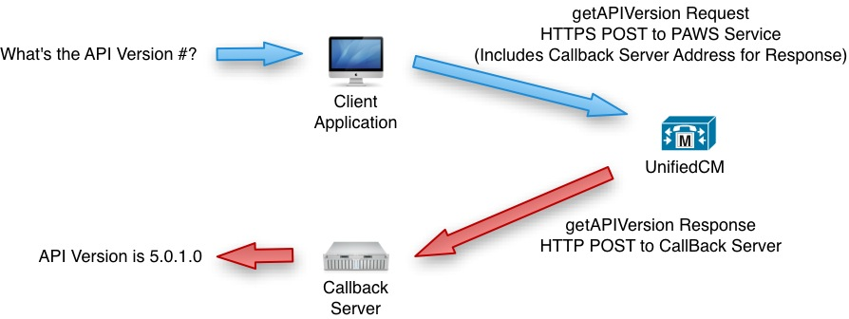
Asynchronous Example of getAPIVersion
Application Interaction with PAWS Service

Slide 32
Asynchronous Code Sample getAPIVersion Request
<?xml version="1.0" encoding="UTF-8"?>
<soapenv:Envelope xmlns:soapenv="http://schemas.xmlsoap.org/soap/envelope/" xmlns:xsd="http://www.w3.org/2001/XMLSchema" xmlns:xsi="http://www.w3.org/2001/XMLSchema-instance">
<soapenv:Header>
<wsa:Action xmlns:wsa="http://schemas.xmlsoap.org/ws/2004/08/addressing">urn:getAPIVersion</wsa:Action>
<wsa:MessageID xmlns:wsa="http://schemas.xmlsoap.org/ws/2004/08/addressing">uuid:63e5d8ca-dcac-40af-916b-d32ec3382d0f</wsa:MessageID>
<wsa:ReplyTo xmlns:wsa="http://schemas.xmlsoap.org/ws/2004/08/addressing">
<wsa:Address>http://192.168.101.101:8888/servlet/WSACallBackHandler</wsa:Address>
<wsa:PortType xmlns:ns1="http://example.org">ns1:LocalPart</wsa:PortType>
</wsa:ReplyTo>
<wsa:To xmlns:wsa="http://schemas.xmlsoap.org/ws/2004/08/addressing">https://192.168.101.99/platform-services/services/APIVersionService.APIVersionServiceHttpSoap11Endpoint</wsa:To>
</soapenv:Header>
<soapenv:Body>
<getAPIVersion xmlns="http://services.api.platform.vos.cisco.com"/>
</soapenv:Body>
</soapenv:Envelope>

Slide 33
Asynchronous Code Sample getAPIVersion Request
<?xml version="1.0" encoding="UTF-8"?>
<soapenv:Envelope xmlns:soapenv="http://schemas.xmlsoap.org/soap/envelope/" xmlns:xsd="http://www.w3.org/2001/XMLSchema" xmlns:xsi="http://www.w3.org/2001/XMLSchema-instance">
<soapenv:Header>
<wsa:Action xmlns:wsa="http://schemas.xmlsoap.org/ws/2004/08/addressing">urn:getAPIVersion</wsa:Action>
<wsa:MessageID xmlns:wsa="http://schemas.xmlsoap.org/ws/2004/08/addressing">uuid:63e5d8ca-dcac-40af-916b-d32ec3382d0f</wsa:MessageID>
<wsa:ReplyTo xmlns:wsa="http://schemas.xmlsoap.org/ws/2004/08/addressing">
<wsa:Address>http://192.168.101.101:8888/servlet/WSACallBackHandler</wsa:Address>
<wsa:PortType xmlns:ns1="http://example.org">ns1:LocalPart</wsa:PortType>
</wsa:ReplyTo>
<wsa:To xmlns:wsa="http://schemas.xmlsoap.org/ws/2004/08/addressing">https://192.168.101.99/platform-services/services/APIVersionService.APIVersionServiceHttpSoap11Endpoint</wsa:To>
</soapenv:Header>
<soapenv:Body>
<getAPIVersion xmlns="http://services.api.platform.vos.cisco.com"/>
</soapenv:Body>
</soapenv:Envelope>
<wsa:Action xmlns:wsa="http://schemas.xmlsoap.org/ws/2004/08/addressing">
urn:getAPIVersion
</wsa:Action>
<wsa:To xmlns:wsa="http://schemas.xmlsoap.org/ws/2004/08/addressing">https://192.168.101.99/platform-services/services/APIVersionService.APIVersionServiceHttpSoap11Endpoint</wsa:To>
<soapenv:Body>
<getAPIVersion xmlns="http://services.api.platform.vos.cisco.com"/>
</soapenv:Body>

Slide 34
Asynchronous Code Sample getAPIVersion Request
<?xml version="1.0" encoding="UTF-8"?>
<soapenv:Envelope xmlns:soapenv="http://schemas.xmlsoap.org/soap/envelope/" xmlns:xsd="http://www.w3.org/2001/XMLSchema" xmlns:xsi="http://www.w3.org/2001/XMLSchema-instance">
<soapenv:Header>
<wsa:Action xmlns:wsa="http://schemas.xmlsoap.org/ws/2004/08/addressing">urn:getAPIVersion</wsa:Action>
<wsa:MessageID xmlns:wsa="http://schemas.xmlsoap.org/ws/2004/08/addressing">uuid:63e5d8ca-dcac-40af-916b-d32ec3382d0f</wsa:MessageID>
<wsa:ReplyTo xmlns:wsa="http://schemas.xmlsoap.org/ws/2004/08/addressing">
<wsa:Address>http://192.168.101.101:8888/servlet/WSACallBackHandler</wsa:Address>
<wsa:PortType xmlns:ns1="http://example.org">ns1:LocalPart</wsa:PortType>
</wsa:ReplyTo>
<wsa:To xmlns:wsa="http://schemas.xmlsoap.org/ws/2004/08/addressing">https://192.168.101.99/platform-services/services/APIVersionService.APIVersionServiceHttpSoap11Endpoint</wsa:To>
</soapenv:Header>
<soapenv:Body>
<getAPIVersion xmlns="http://services.api.platform.vos.cisco.com"/>
</soapenv:Body>
</soapenv:Envelope>
<wsa:MessageID xmlns:wsa="http://schemas.xmlsoap.org/ws/2004/08/addressing">
uuid:63e5d8ca-dcac-40af-916b-d32ec3382d0f
</wsa:MessageID>
<wsa:ReplyTo xmlns:wsa="http://schemas.xmlsoap.org/ws/2004/08/addressing">
<wsa:Address>
http://192.168.101.101:8888/servlet/WSACallBackHandler
</wsa:Address>
<wsa:PortType xmlns:ns1="http://example.org">
ns1:LocalPart
</wsa:PortType>
</wsa:ReplyTo>

Slide 35
Asynchronous Code Sample getAPIVersion Response
<soapenv:Envelope xmlns:soapenv="http://schemas.xmlsoap.org/soap/envelope/">
<soapenv:Header xmlns:wsa="http://schemas.xmlsoap.org/ws/2004/08/addressing">
<wsa:To>http://192.168.101.101:8888/servlet/WSACallBackHandler</wsa:To>
<wsa:MessageID>urn:uuid:0F61829901A8890A521333714855344</wsa:MessageID>
<wsa:Action>urn:getAPIVersionResponse</wsa:Action>
<wsa:RelatesTo>uuid:63e5d8ca-dcac-40af-916b-d32ec3382d0f</wsa:RelatesTo>
</soapenv:Header>
<soapenv:Body>
<ns:getAPIVersionResponse xmlns:ns="http://services.api.platform.vos.cisco.com">
<ns:return xmlns:ax21="http://element.services.api.platform.vos.cisco.com/xsd" … >
<ax21:result>internal.request.complete</ax21:result>
<ax21:APIVersion>5.0.1.0</ax21:APIVersion>
</ns:return>
</ns:getAPIVersionResponse>
</soapenv:Body>
</soapenv:Envelope>

Slide 36
Asynchronous Code Sample getAPIVersion Response
<soapenv:Envelope xmlns:soapenv="http://schemas.xmlsoap.org/soap/envelope/">
<soapenv:Header xmlns:wsa="http://schemas.xmlsoap.org/ws/2004/08/addressing">
<wsa:To>http://192.168.101.101:8888/servlet/WSACallBackHandler</wsa:To>
<wsa:MessageID>urn:uuid:0F61829901A8890A521333714855344</wsa:MessageID>
<wsa:Action>urn:getAPIVersionResponse</wsa:Action>
<wsa:RelatesTo>uuid:63e5d8ca-dcac-40af-916b-d32ec3382d0f</wsa:RelatesTo>
</soapenv:Header>
<soapenv:Body>
<ns:getAPIVersionResponse xmlns:ns="http://services.api.platform.vos.cisco.com">
<ns:return xmlns:ax21="http://element.services.api.platform.vos.cisco.com/xsd" … >
<ax21:result>internal.request.complete</ax21:result>
<ax21:APIVersion>5.0.1.0</ax21:APIVersion>
</ns:return>
</ns:getAPIVersionResponse>
</soapenv:Body>
</soapenv:Envelope>
<wsa:To>http://192.168.101.101:8888/servlet/WSACallBackHandler</wsa:To>
<wsa:MessageID>urn:uuid:0F61829901A8890A521333714855344</wsa:MessageID>
<wsa:Action>urn:getAPIVersionResponse</wsa:Action>
<wsa:RelatesTo>uuid:63e5d8ca-dcac-40af-916b-d32ec3382d0f</wsa:RelatesTo>
<ns:return xmlns:ax21="http://element.services.api.platform.vos.cisco.com/xsd" … >
<ax21:result>internal.request.complete</ax21:result>
<ax21:APIVersion>5.0.1.0</ax21:APIVersion>
</ns:return>

Slide 37
Typical use cases

Slide 38
Examples of Applications that can use PAWS
Discovering cluster nodes
Downloading and Verifying that upgrade files are on each server
Managing backup jobs
Restarting server nodes
Performing upgrades

Slide 39
Typical Use Cases
Managing A Cluster Upgrade (Streamlined)
Identify nodes in the cluster
Validate installed versions of Unified CM
Verify upgrade validity
Download and prepare upgrade file on server
Start the upgrade
Check status of upgrade
Switch to upgraded software version

Slide 40
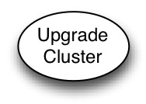
Example: Managing a Cluster Upgrade with PAWS

Slide 41
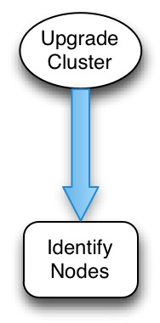
Example: Managing a Cluster Upgrade with PAWS

Slide 42
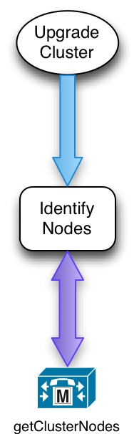
Example: Managing a Cluster Upgrade with PAWS

Slide 43
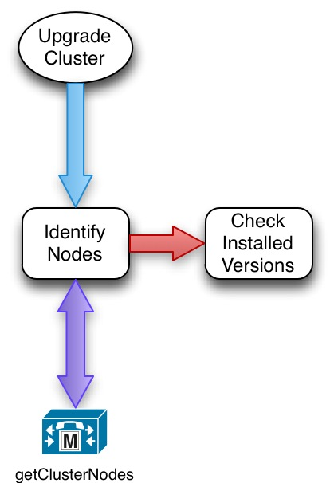
Example: Managing a Cluster Upgrade with PAWS

Slide 44
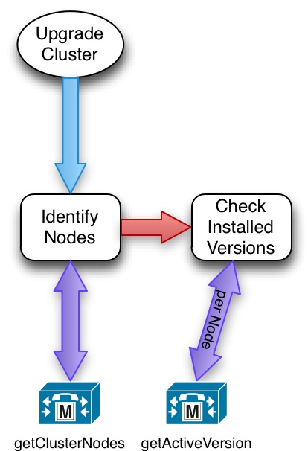
Example: Managing a Cluster Upgrade with PAWS

Slide 45
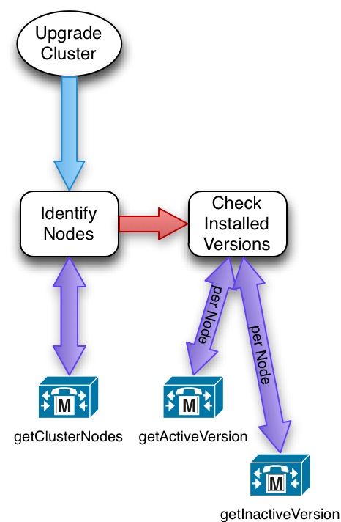
Example: Managing a Cluster Upgrade with PAWS

Slide 46
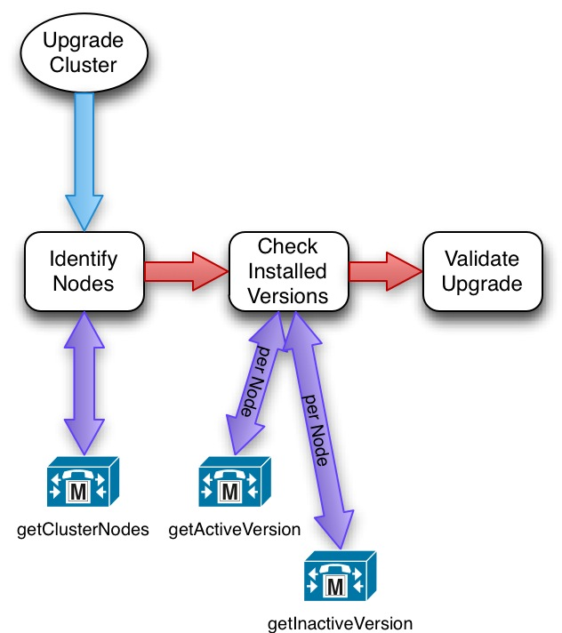
Example: Managing a Cluster Upgrade with PAWS

Slide 47
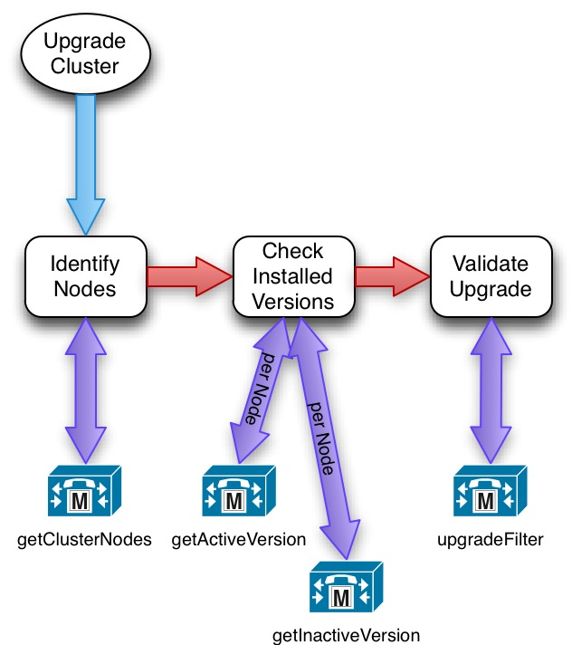
Example: Managing a Cluster Upgrade with PAWS

Slide 48
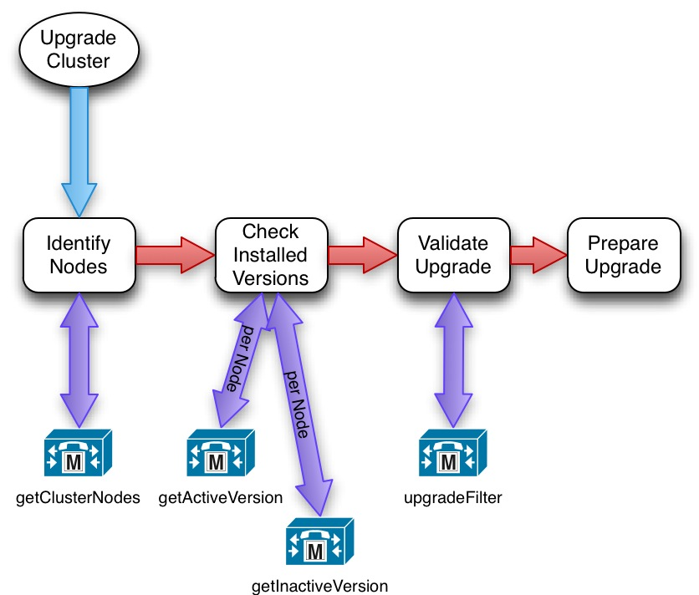
Example: Managing a Cluster Upgrade with PAWS

Slide 49
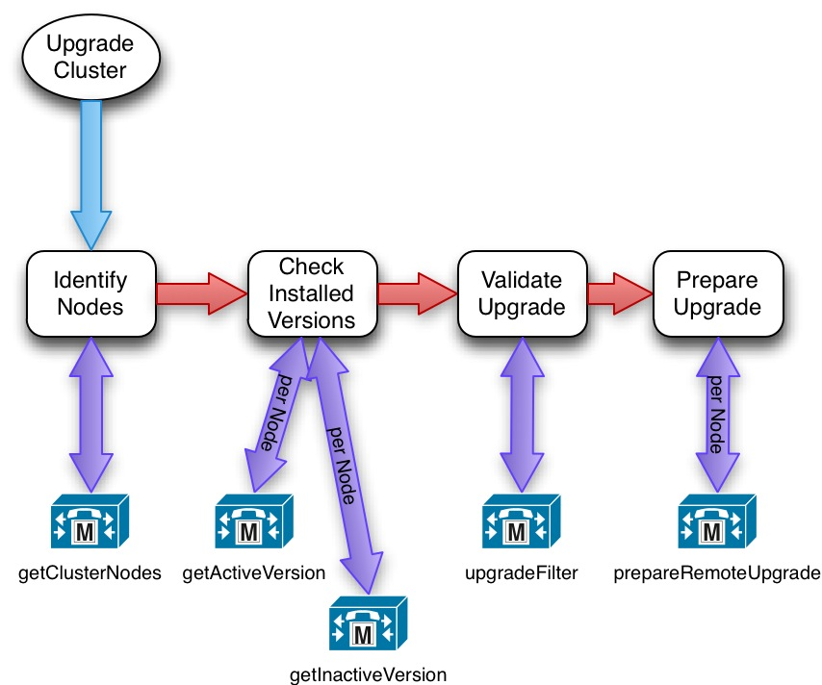
Example: Managing a Cluster Upgrade with PAWS

Slide 50
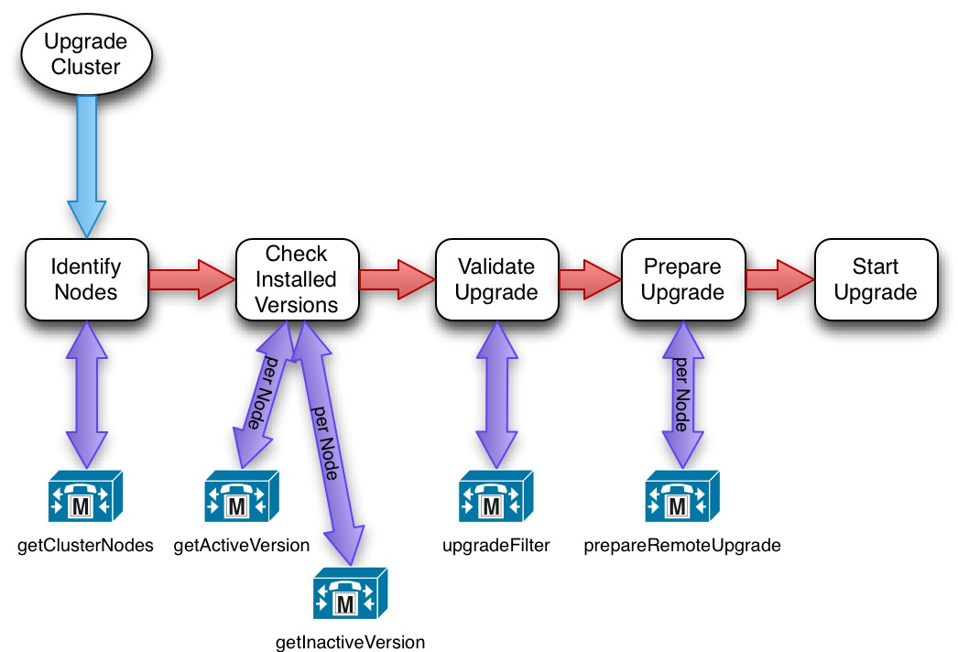
Example: Managing a Cluster Upgrade with PAWS

Slide 51
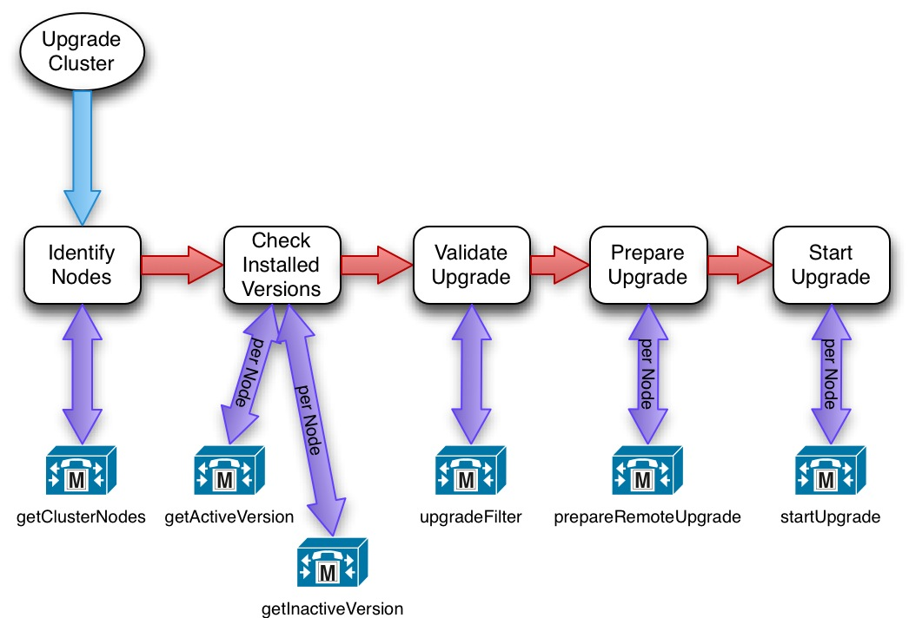
Example: Managing a Cluster Upgrade with PAWS

Slide 52
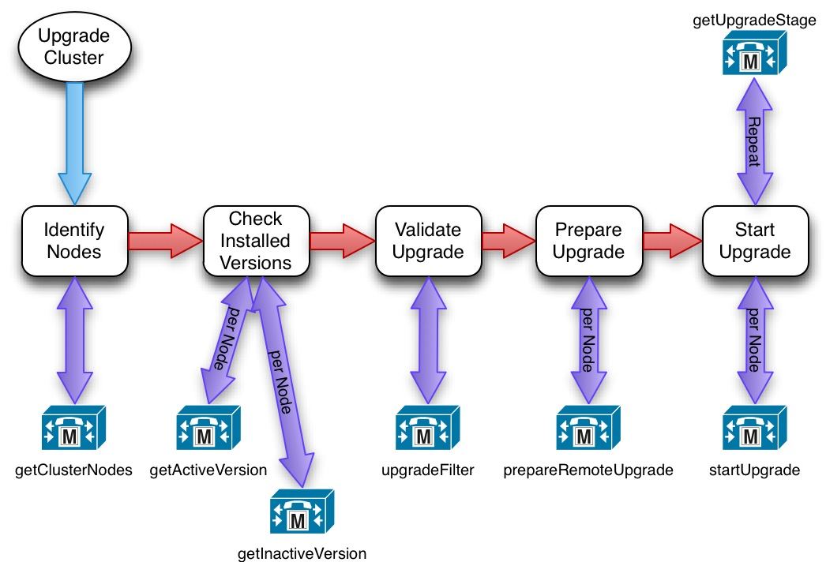
Example: Managing a Cluster Upgrade with PAWS

Slide 53
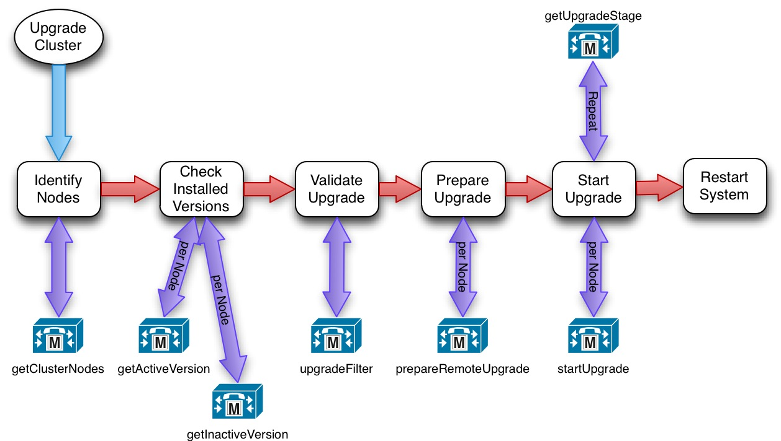
Example: Managing a Cluster Upgrade with PAWS

Slide 54
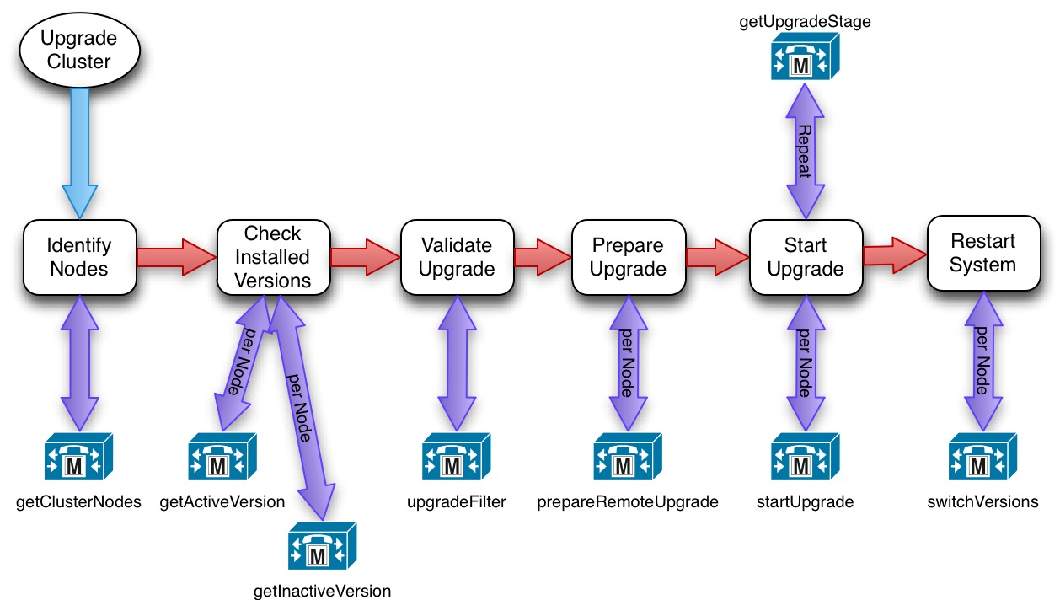
Example: Managing a Cluster Upgrade with PAWS

Slide 55
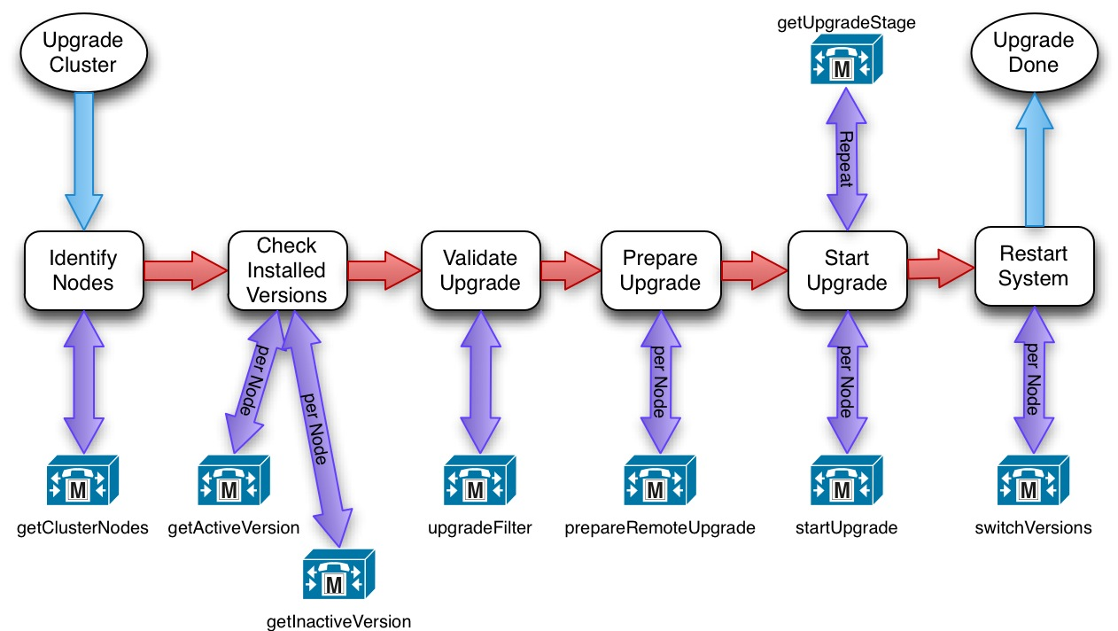
Example: Managing a Cluster Upgrade with PAWS

Slide 56
Typical Use Cases
Identify Nodes in the Cluster
ClusterNodeService
  Service provides two interfaces
  getClusterNodes returns details on all nodes in the cluster
  getMyClusterNode returns details on the node the request is made to
Each node in the cluster has a ClusterNode element in the response
ClusterNode element includes the following (plus additional fields):
  address - IP address of the node
  alias - an alpha-numeric identifier for the node
  hostname - the URL of the node's host server
  type - cluster.node.type.primary or cluster.node.type.secondary

Slide 57
Typical Use Cases
Validate Installed Version
VersionInformationService
  Service provides two interfaces
  getActiveVersion
  getInactiveVersion
Service response includes either a getActiveVersionResponse or a getInactiveVersionResponse element
Response Element includes:
  Version installed on the server
  For example: 8.6.0.98000-9005
  Version will be “empty” if no inactive version is present

Slide 58
Typical use cases
Verify Upgrade Validity
UpgradeFilterService
  Service provides one interface:
  upgradeFilter
Two possible responses:
  A list of valid files from the list provided in the request
  A message indicating that none of the files in the request are present
Successful response element includes:
  Valid file name(s)
  For example, UCSInstall_UCOS_8.6.0.96000-9007.iso

Slide 59
Typical use cases
Download and Prepare Upgrade
PrepareRemoteUpgradeService
  Service provides one interface:
  prepareRemoteUpgrade
Downloads and prepares an upgrade or COP file for installation
Responses can indicate a success or a failure
  Failures will include information indicating the source of the failure
  Responses will generally echo back the parameters sent in the request
Query the status of Request with UpgradeStageService

Slide 60
Typical use cases
Start the Upgrade
StartUpgradeService
  Service provides one interface
  startUpgrade
Request must include a ‘Session ID’ which should be used to ensure that only one upgrade process is being managed at once.
Responses can indicate a success or a failure
  Failures will include information indicating the source of the failure
  Responses will generally echo back the parameters sent in the request

Slide 61
Typical use cases
Check Status of Upgrade
UpgradeStageService
  Service provides one interface
  getUpgradeStage
Returns the current overall upgrade or COP file installation stage
Stages include (not a complete list here):
  Cancelled
  Completed
  Configuring
  Downloading
  Error
  Installing

Slide 62
Typical use cases
Switch Versions and Restart
SwitchVersionService
  Service provides one interface
  switchVersions
Activates and boots the inactive partition
You can use SwitchVersionStatusService to check the status of switchVersions
No response when switchVersions completes because of server restart
Failure response provides some indication of what went wrong
  such as no inactive version being present

Slide 63
Step 1: Identify Nodes in the Cluster

Slide 64
getClusterNodes Request
<?xml version="1.0" encoding="UTF-8"?>
<soapenv:Envelope xmlns:soapenv="http://schemas.xmlsoap.org/soap/envelope/" xmlns:xsd="http://www.w3.org/2001/XMLSchema" xmlns:xsi="http://www.w3.org/2001/XMLSchema-instance">
<soapenv:Header>
<wsa:Action xmlns:wsa="http://schemas.xmlsoap.org/ws/2004/08/addressing">urn:getClusterNodes</wsa:Action>
<wsa:MessageID xmlns:wsa="http://schemas.xmlsoap.org/ws/2004/08/addressing">
uuid:7481e8cf-ba47-49dc-9566-b52596fd4444
</wsa:MessageID>
<wsa:ReplyTo xmlns:wsa="http://schemas.xmlsoap.org/ws/2004/08/addressing">
<wsa:Address>http://192.168.101.101:8888/servlet/WSACallBackHandler</wsa:Address>
<wsa:PortType xmlns:ns1="http://example.org">ns1:LocalPart</wsa:PortType>
</wsa:ReplyTo>
<wsa:To xmlns:wsa="http://schemas.xmlsoap.org/ws/2004/08/addressing">https://192.168.101.99/platform-services/services/ClusterNodesService.ClusterNodesServiceHttpSoap11Endpoint</wsa:To>
</soapenv:Header>
<soapenv:Body>
<getClusterNodes xmlns="http://services.api.platform.vos.cisco.com"/>
</soapenv:Body>
</soapenv:Envelope>

Slide 65
getClusterNodes Response
<soapenv:Envelope xmlns:soapenv="http://schemas.xmlsoap.org/soap/envelope/">
<soapenv:Header xmlns:wsa="http://schemas.xmlsoap.org/ws/2004/08/addressing">
<wsa:To>http://192.168.101.101:8888/servlet/WSACallBackHandler</wsa:To>
<wsa:MessageID>urn:uuid:0F61829901A8890A521333718694943</wsa:MessageID>
<wsa:Action>urn:getClusterNodesResponse</wsa:Action>
<wsa:RelatesTo>uuid:7481e8cf-ba47-49dc-9566-b52596fd4444</wsa:RelatesTo>
</soapenv:Header>
<soapenv:Body>
<ns:getClusterNodesResponse xmlns:ns="http://services.api.platform.vos.cisco.com">
<ns:return xmlns:ax214="http://api.platform.vos.cisco.com/xsd" xmlns:ax213="http://element.services.api.platform.vos.cisco.com/xsd" xmlns:xsi="http://www.w3.org/2001/XMLSchema-instance" xsi:type="ax213:ClusterNodesResponse">
<ax213:result>internal.request.complete</ax213:result>
<ax213:clusterNodes xsi:type="ax213:ClusterNode">
<ax213:address>192.168.101.99</ax213:address>
<ax213:alias>cucm</ax213:alias>
<ax213:hostname>192.168.101.99</ax213:hostname>
<ax213:primary>true</ax213:primary>
<ax213:primaryNode>192.168.101.99</ax213:primaryNode>
<ax213:secondary>false</ax213:secondary>
<ax213:type>cluster.node.type.primary</ax213:type>
</ax213:clusterNodes>
</ns:return>
</ns:getClusterNodesResponse>
</soapenv:Body>
</soapenv:Envelope>

Slide 66
getClusterNodes Response
<soapenv:Envelope xmlns:soapenv="http://schemas.xmlsoap.org/soap/envelope/">
<soapenv:Header xmlns:wsa="http://schemas.xmlsoap.org/ws/2004/08/addressing">
<wsa:To>http://192.168.101.101:8888/servlet/WSACallBackHandler</wsa:To>
<wsa:MessageID>urn:uuid:0F61829901A8890A521333718694943</wsa:MessageID>
<wsa:Action>urn:getClusterNodesResponse</wsa:Action>
<wsa:RelatesTo>uuid:7481e8cf-ba47-49dc-9566-b52596fd4444</wsa:RelatesTo>
</soapenv:Header>
<soapenv:Body>
<ns:getClusterNodesResponse xmlns:ns="http://services.api.platform.vos.cisco.com">
<ns:return xmlns:ax214="http://api.platform.vos.cisco.com/xsd" xmlns:ax213="http://element.services.api.platform.vos.cisco.com/xsd" xmlns:xsi="http://www.w3.org/2001/XMLSchema-instance" xsi:type="ax213:ClusterNodesResponse">
<ax213:result>internal.request.complete</ax213:result>
<ax213:clusterNodes xsi:type="ax213:ClusterNode">
<ax213:address>192.168.101.99</ax213:address>
<ax213:alias>cucm</ax213:alias>
<ax213:hostname>192.168.101.99</ax213:hostname>
<ax213:primary>true</ax213:primary>
<ax213:primaryNode>192.168.101.99</ax213:primaryNode>
<ax213:secondary>false</ax213:secondary>
<ax213:type>cluster.node.type.primary</ax213:type>
</ax213:clusterNodes>
</ns:return>
</ns:getClusterNodesResponse>
</soapenv:Body>
</soapenv:Envelope>
<wsa:To>http://192.168.101.101:8888/servlet/WSACallBackHandler</wsa:To>
<wsa:MessageID>urn:uuid:0F61829901A8890A521333718694943</wsa:MessageID>
<wsa:Action>urn:getClusterNodesResponse</wsa:Action>
<wsa:RelatesTo>uuid:7481e8cf-ba47-49dc-9566-b52596fd4444</wsa:RelatesTo>

Slide 67
getClusterNodes Response Body
<soapenv:Body>
<ns:getClusterNodesResponse xmlns:ns="http://services.api.platform.vos.cisco.com">
<ns:return xmlns:ax214="http://api.platform.vos.cisco.com/xsd" … >
<ax213:result>internal.request.complete</ax213:result>
<ax213:clusterNodes xsi:type="ax213:ClusterNode">
<ax213:address>192.168.101.99</ax213:address>
<ax213:alias>cucm</ax213:alias>
<ax213:hostname>192.168.101.99</ax213:hostname>
<ax213:primary>true</ax213:primary>
<ax213:primaryNode>192.168.101.99</ax213:primaryNode>
<ax213:secondary>false</ax213:secondary>
<ax213:type>cluster.node.type.primary</ax213:type>
</ax213:clusterNodes>
</ns:return>
</ns:getClusterNodesResponse>
</soapenv:Body>
One ClusterNode response for each node in the cluster

Slide 68
Step2: Validate Active Version

Slide 69
getActiveVersion Request
<?xml version="1.0" encoding="UTF-8"?>
<soapenv:Envelope xmlns:soapenv="http://schemas.xmlsoap.org/soap/envelope/" xmlns:xsd="http://www.w3.org/2001/XMLSchema" xmlns:xsi="http://www.w3.org/2001/XMLSchema-instance">
<soapenv:Header>
<wsa:Action xmlns:wsa="http://schemas.xmlsoap.org/ws/2004/08/addressing">urn:getActiveVersion</wsa:Action>
<wsa:MessageID xmlns:wsa="http://schemas.xmlsoap.org/ws/2004/08/addressing">uuid:7481e8cf-ba47-49dc-9566-b52596fd4444</wsa:MessageID>
<wsa:ReplyTo xmlns:wsa="http://schemas.xmlsoap.org/ws/2004/08/addressing">
<wsa:Address>http://192.168.101.101:8888/servlet/WSACallBackHandler</wsa:Address>
<wsa:PortType xmlns:ns1="http://example.org">ns1:LocalPart</wsa:PortType>
</wsa:ReplyTo>
<wsa:To xmlns:wsa="http://schemas.xmlsoap.org/ws/2004/08/addressing">https://192.168.101.99/platform-services/services/VersionService.VersionServiceHttpSoap11Endpoint</wsa:To>
</soapenv:Header>
<soapenv:Body>
<getActiveVersion xmlns="http://services.api.platform.vos.cisco.com"/>
</soapenv:Body>
</soapenv:Envelope>

Slide 70
getActiveVersion Response
<soapenv:Envelope xmlns:soapenv="http://schemas.xmlsoap.org/soap/envelope/">
<soapenv:Header xmlns:wsa="http://schemas.xmlsoap.org/ws/2004/08/addressing">
<wsa:To>http://192.168.101.101:8888/servlet/WSACallBackHandler</wsa:To>
<wsa:MessageID>urn:uuid:0F61829901A8890A521333724069617</wsa:MessageID>
<wsa:Action>urn:getActiveVersionResponse</wsa:Action>
<wsa:RelatesTo>uuid:7481e8cf-ba47-49dc-9566-b52596fd4444</wsa:RelatesTo>
</soapenv:Header>
<soapenv:Body>
<ns:getActiveVersionResponse xmlns:ns="http://services.api.platform.vos.cisco.com">
<ns:return xmlns:ax217="http://element.services.api.platform.vos.cisco.com/xsd" … >
<ax217:remoteMessages xsi:nil="true" />
<ax217:result>internal.request.complete</ax217:result>
<ax217:version>9.0.0.98000-104</ax217:version>
</ns:return>
</ns:getActiveVersionResponse>
</soapenv:Body>
</soapenv:Envelope>
<ax217:result>internal.request.complete</ax217:result>
<ax217:version>9.0.0.98000-104</ax217:version>

Slide 71
Step2: Validate Inactive Version

Slide 72
getInactiveVersion Request
<?xml version="1.0" encoding="UTF-8"?>
<soapenv:Envelope xmlns:soapenv="http://schemas.xmlsoap.org/soap/envelope/" xmlns:xsd="http://www.w3.org/2001/XMLSchema" xmlns:xsi="http://www.w3.org/2001/XMLSchema-instance">
<soapenv:Header>
<wsa:Action xmlns:wsa="http://schemas.xmlsoap.org/ws/2004/08/addressing">urn:getInactiveVersion</wsa:Action>
<wsa:MessageID xmlns:wsa="http://schemas.xmlsoap.org/ws/2004/08/addressing">uuid:7481e8cf-ba47-49dc-9566-b52596fd4444</wsa:MessageID>
<wsa:ReplyTo xmlns:wsa="http://schemas.xmlsoap.org/ws/2004/08/addressing">
<wsa:Address>http://192.168.101.101:8888/servlet/WSACallBackHandler</wsa:Address>
<wsa:PortType xmlns:ns1="http://example.org">ns1:LocalPart</wsa:PortType>
</wsa:ReplyTo>
<wsa:To xmlns:wsa="http://schemas.xmlsoap.org/ws/2004/08/addressing">https://192.168.101.99/platform-services/services/VersionService.VersionServiceHttpSoap11Endpoint</wsa:To>
</soapenv:Header>
<soapenv:Body>
<getInactiveVersion xmlns="http://services.api.platform.vos.cisco.com"/>
</soapenv:Body>
</soapenv:Envelope>

Slide 73
getInactiveVersion Response
<soapenv:Envelope xmlns:soapenv="http://schemas.xmlsoap.org/soap/envelope/">
<soapenv:Header xmlns:wsa="http://schemas.xmlsoap.org/ws/2004/08/addressing">
<wsa:To>http://192.168.101.101:8888/servlet/WSACallBackHandler</wsa:To>
<wsa:MessageID>urn:uuid:0F61829901A8890A521333724069617</wsa:MessageID>
<wsa:Action>urn:getInactiveVersionResponse</wsa:Action>
<wsa:RelatesTo>uuid:7481e8cf-ba47-49dc-9566-b52596fd4444</wsa:RelatesTo>
</soapenv:Header>
<soapenv:Body>
<ns:getInactiveVersionResponse xmlns:ns="http://services.api.platform.vos.cisco.com">
<ns:return xmlns:ax217="http://element.services.api.platform.vos.cisco.com/xsd" … >
<ax217:remoteMessages xsi:nil="true" />
<ax217:result>internal.request.complete</ax217:result>
<ax217:version></ax217:version>
</ns:return>
</ns:getInactiveVersionResponse>
</soapenv:Body>
</soapenv:Envelope>
<ax217:result>internal.request.complete</ax217:result>
<ax217:version></ax217:version>

Slide 74
Step 3: Verify Upgrade Validity

Slide 75
upgradeFilter Request
<?xml version="1.0" encoding="UTF-8"?>
<soapenv:Envelope xmlns:soapenv="http://schemas.xmlsoap.org/soap/envelope/" … >
<soapenv:Header>
<wsa:Action xmlns:wsa="http://schemas.xmlsoap.org/ws/2004/08/addressing">urn:upgradeFilter</wsa:Action>
<wsa:MessageID xmlns:wsa="http://schemas.xmlsoap.org/ws/2004/08/addressing">uuid:7481e8cf-ba47-49dc-9566-b52596fd4444</wsa:MessageID>
<wsa:ReplyTo xmlns:wsa="http://schemas.xmlsoap.org/ws/2004/08/addressing">
<wsa:Address>http://192.168.101.101:8888/servlet/WSACallBackHandler</wsa:Address>
<wsa:PortType xmlns:ns1="http://example.org">ns1:LocalPart</wsa:PortType>
</wsa:ReplyTo>
<wsa:To xmlns:wsa="http://schemas.xmlsoap.org/ws/2004/08/addressing">https://192.168.101.99/platform-services/services/UpgradeFilterService.UpgradeFilterServiceHttpSoap11Endpoint</wsa:To>
</soapenv:Header>
<soapenv:Body>
<upgradeFilter xmlns="http://services.api.platform.vos.cisco.com">
<args0>install/upgrade</args0>
<args1>UCSInstall_UCOS_9.0.0.98000-146.iso</args1>
<args1>UCSInstall_UCOS_9.0.0.98000-148.iso</args1>
</upgradeFilter>
</soapenv:Body>
</soapenv:Envelope>
<soapenv:Body>
<upgradeFilter xmlns="http://services.api.platform.vos.cisco.com">
<args0>install/upgrade</args0>
<args1>UCSInstall_UCOS_9.0.0.98000-146.iso</args1>
<args1>UCSInstall_UCOS_9.0.0.98000-148.iso</args1>
</upgradeFilter>
</soapenv:Body>

Slide 76
upgradeFilter Response
<soapenv:Envelope xmlns:soapenv="http://schemas.xmlsoap.org/soap/envelope/">
<soapenv:Header xmlns:wsa="http://schemas.xmlsoap.org/ws/2004/08/addressing">
<wsa:To>http://192.168.101.101:8888/servlet/WSACallBackHandler</wsa:To>
<wsa:MessageID>urn:uuid:0F61829901A8890A521333728661554</wsa:MessageID>
<wsa:Action>urn:upgradeFilterResponse</wsa:Action>
<wsa:RelatesTo>uuid:7481e8cf-ba47-49dc-9566-b52596fd4444</wsa:RelatesTo>
</soapenv:Header>
<soapenv:Body>
<ns:upgradeFilterResponse xmlns:ns="http://services.api.platform.vos.cisco.com">
<ns:return xmlns:ax233="http://element.services.api.platform.vos.cisco.com/xsd" … >
<ax233:result>internal.request.complete</ax233:result>
<ax233:upgradeFiles>UCSInstall_UCOS_9.0.0.98000-146.iso</ax233:upgradeFiles>
<ax233:upgradeFiles>UCSInstall_UCOS_9.0.0.98000-148.iso</ax233:upgradeFiles>
</ns:return>
</ns:upgradeFilterResponse>
</soapenv:Body>
</soapenv:Envelope>
<ns:upgradeFilterResponse xmlns:ns="http://services.api.platform.vos.cisco.com">
<ns:return xmlns:ax233="http://element.services.api.platform.vos.cisco.com/xsd" … >
<ax233:result>internal.request.complete</ax233:result>
<ax233:upgradeFiles>
UCSInstall_UCOS_9.0.0.98000-146.iso
</ax233:upgradeFiles>
<ax233:upgradeFiles>
UCSInstall_UCOS_9.0.0.98000-148.iso
</ax233:upgradeFiles>
</ns:return>
</ns:upgradeFilterResponse>

Slide 77
Step 4: Download & Prepare Upgrade File

Slide 78
prepareRemoteUpgrade Request (Header)
<soapenv:Header>
<wsa:Action xmlns:wsa="http://schemas.xmlsoap.org/ws/2004/08/addressing">urn:prepareRemoteUpgrade</wsa:Action>
<wsa:MessageID xmlns:wsa="http://schemas.xmlsoap.org/ws/2004/08/addressing">uuid:7481e8cf-ba47-49dc-9566-b52596fd4444</wsa:MessageID>
<wsa:ReplyTo xmlns:wsa="http://schemas.xmlsoap.org/ws/2004/08/addressing">
<wsa:Address>http://192.168.101.101:8888/servlet/WSACallBackHandler</wsa:Address>
<wsa:PortType xmlns:ns1="http://example.org">ns1:LocalPart</wsa:PortType>
</wsa:ReplyTo>
<wsa:To xmlns:wsa="http://schemas.xmlsoap.org/ws/2004/08/addressing">
https://192.168.101.99/platform-services/services/PrepareRemoteUpgradeService.PrepareRemoteUpgradeServiceHttpSoap11Endpoint
</wsa:To>
</soapenv:Header>

Slide 79
prepareRemoteUpgrade Request (Body)
<soapenv:Body>
<prepareRemoteUpgrade xmlns="http://services.api.platform.vos.cisco.com">
<args0>
<nsname:name xmlns:nsname="http://element.api.platform.vos.cisco.com/xsd">
UCSInstall_UCOS_9.0.0.98000-133.iso
</nsname:name>
<nspath:path xmlns:nspath="http://element.api.platform.vos.cisco.com/xsd">Upgrades</nspath:path>
<nspass:password xmlns:nspass="http://element.api.platform.vos.cisco.com/xsd">cisco</nspass:password>
<nsserv:server xmlns:nsserv="http://element.api.platform.vos.cisco.com/xsd">192.168.101.101</nsserv:server>
<nsloc:upgradeLocation xmlns:nsloc="http://element.api.platform.vos.cisco.com/xsd">
upgradefile.location.remote.sftp
</nsloc:upgradeLocation>
<nstyp:upgradeType xmlns:nstyp="http://element.api.platform.vos.cisco.com/xsd">install/upgrade</nstyp:upgradeType>
<nsuser:user xmlns:nsuser="http://element.api.platform.vos.cisco.com/xsd">admin</nsuser:user>
</args0>
<args1>session0001</args1>
<args2>false</args2>
</prepareRemoteUpgrade>
</soapenv:Body>
<nsname:name xmlns:nsname="http://element.api.platform.vos.cisco.com/xsd">
UCSInstall_UCOS_9.0.0.98000-133.iso
</nsname:name>
<nspath:path xmlns:nspath="http://element.api.platform.vos.cisco.com/xsd">
Upgrades
</nspath:path>
<nspass:password xmlns:nspass="http://element.api.platform.vos.cisco.com/xsd">
cisco
</nspass:password>
<nsserv:server xmlns:nsserv="http://element.api.platform.vos.cisco.com/xsd">
192.168.101.101
</nsserv:server>
<nsloc:upgradeLocation xmlns:nsloc="http://element.api.platform.vos.cisco.com/xsd">
upgradefile.location.remote.sftp
</nsloc:upgradeLocation>
<nstyp:upgradeType xmlns:nstyp="http://element.api.platform.vos.cisco.com/xsd">
install/upgrade
</nstyp:upgradeType>
<nsuser:user xmlns:nsuser="http://element.api.platform.vos.cisco.com/xsd">
admin
</nsuser:user>

Slide 80
prepareRemoteUpgrade Response (Body)
<soapenv:Body>
<ns:prepareRemoteUpgradeResponse xmlns:ns="http://services.api.platform.vos.cisco.com">
<ns:return xmlns:ax241="http://element.services.api.platform.vos.cisco.com/xsd" … >
<ax241:remoteMessages xsi:type="ax241:RemoteMessage">
<ax243:error>false</ax243:error><ax243:info>false</ax243:info>
<ax243:messageKey>warning.upgrade.rebootrequired</ax243:messageKey>
<ax243:messageType>internal.message.warning</ax243:messageType><ax243:warning>true</ax243:warning>
</ax241:remoteMessages>
<ax241:result>internal.request.complete.message</ax241:result>
<ax241:upgradeFile xsi:type="ax241:UpgradeFile">
<ax241:name>UCSInstall_UCOS_9.0.0.98000-133.iso</ax241:name>
<ax241:password>cisco</ax241:password>
<ax241:path>Upgrades</ax241:path>
<ax241:server>192.168.101.101</ax241:server>
<ax241:upgradeLocation>upgradefile.location.remote.sftp</ax241:upgradeLocation>
<ax241:upgradeType>install/upgrade</ax241:upgradeType>
<ax241:user>admin</ax241:user>
</ax241:upgradeFile>
</ns:return>
</ns:prepareRemoteUpgradeResponse>
</soapenv:Body>
<ax241:remoteMessages xsi:type="ax241:RemoteMessage">
<ax243:error>false</ax243:error>
<ax243:info>false</ax243:info>
<ax243:messageKey>warning.upgrade.rebootrequired</ax243:messageKey>
<ax243:messageType>internal.message.warning</ax243:messageType>
<ax243:warning>true</ax243:warning>
</ax241:remoteMessages>
<ax241:result>internal.request.complete.message</ax241:result>
<ax241:upgradeFile xsi:type="ax241:UpgradeFile">
<ax241:name>UCSInstall_UCOS_9.0.0.98000-133.iso</ax241:name>
<ax241:password>cisco</ax241:password>
<ax241:path>Upgrades</ax241:path>
<ax241:server>192.168.101.101</ax241:server>
<ax241:upgradeLocation>upgradefile.location.remote.sftp</ax241:upgradeLocation>
<ax241:upgradeType>install/upgrade</ax241:upgradeType>
<ax241:user>admin</ax241:user>
</ax241:upgradeFile>

Slide 81
Step 5: Start the Upgrade

Slide 82
startUpgrade Request
<soapenv:Envelope xmlns:soapenv="http://schemas.xmlsoap.org/soap/envelope/" xmlns:xsd="http://www.w3.org/2001/XMLSchema" xmlns:xsi="http://www.w3.org/2001/XMLSchema-instance">
<soapenv:Header>
<wsa:Action xmlns:wsa="http://schemas.xmlsoap.org/ws/2004/08/addressing">urn:startUpgrade</wsa:Action>
<wsa:MessageID xmlns:wsa="http://schemas.xmlsoap.org/ws/2004/08/addressing">uuid:7481e8cf-ba47-49dc-9566-b52596fd4444</wsa:MessageID>
<wsa:ReplyTo xmlns:wsa="http://schemas.xmlsoap.org/ws/2004/08/addressing">
<wsa:Address>http://192.168.101.101:8888/servlet/WSACallBackHandler</wsa:Address>
<wsa:PortType xmlns:ns1="http://example.org">ns1:LocalPart</wsa:PortType>
</wsa:ReplyTo>
<wsa:To xmlns:wsa="http://schemas.xmlsoap.org/ws/2004/08/addressing">https://192.168.101.99/platform-services/services/StartUpgradeService.StartUpgradeServiceHttpSoap11Endpoint</wsa:To>
</soapenv:Header>
<soapenv:Body>
<startUpgrade xmlns="http://services.api.platform.vos.cisco.com">
<args0>session0001</args0>
<args1>false</args1>
<args2>false</args2>
</startUpgrade>
</soapenv:Body>
</soapenv:Envelope>
<soapenv:Body>
<startUpgrade xmlns="http://services.api.platform.vos.cisco.com">
<args0>session0001</args0>
<args1>false</args1>
<args2>false</args2>
</startUpgrade>
</soapenv:Body>

Slide 83
startUpgrade Response (Body)
<soapenv:Body>
<ns:startUpgradeResponse xmlns:ns="http://services.api.platform.vos.cisco.com">
<ns:return xmlns:ax246="http://api.platform.vos.cisco.com/xsd" … >
<ax245:remoteMessages xsi:type="ax245:RemoteMessage">
<ax246:error>false</ax246:error>
<ax246:info>true</ax246:info>
<ax246:messageKey>info.upgrade.switchrequired</ax246:messageKey>
<ax246:messageType>internal.message.info</ax246:messageType>
<ax246:warning>false</ax246:warning>
</ax245:remoteMessages>
<ax245:result>internal.request.complete.message</ax245:result>
</ns:return>
</ns:startUpgradeResponse>
</soapenv:Body>

Slide 84
Step 6: Check Status of Upgrade

Slide 85
getUpgradeStage Request
<soapenv:Envelope xmlns:soapenv="http://schemas.xmlsoap.org/soap/envelope/" xmlns:xsd="http://www.w3.org/2001/XMLSchema" xmlns:xsi="http://www.w3.org/2001/XMLSchema-instance">
<soapenv:Header>
<wsa:Action xmlns:wsa="http://schemas.xmlsoap.org/ws/2004/08/addressing">urn:getUpgradeStage</wsa:Action>
<wsa:MessageID xmlns:wsa="http://schemas.xmlsoap.org/ws/2004/08/addressing">
uuid:7481e8cf-ba47-49dc-9566-b52596fd4444
</wsa:MessageID>
<wsa:ReplyTo xmlns:wsa="http://schemas.xmlsoap.org/ws/2004/08/addressing">
<wsa:Address>http://192.168.101.101:8888/servlet/WSACallBackHandler</wsa:Address>
<wsa:PortType xmlns:ns1="http://example.org">ns1:LocalPart</wsa:PortType>
</wsa:ReplyTo>
<wsa:To xmlns:wsa="http://schemas.xmlsoap.org/ws/2004/08/addressing">https://192.168.101.99/platform-services/services/UpgradeStageService.UpgradeStageServiceHttpSoap11Endpoint</wsa:To>
</soapenv:Header>
<soapenv:Body>
<getUpgradeStage xmlns="http://services.api.platform.vos.cisco.com"/>
</soapenv:Body>
</soapenv:Envelope>
<soapenv:Body>
<getUpgradeStage xmlns="http://services.api.platform.vos.cisco.com"/>
</soapenv:Body>

Slide 86
getUpgradeStage Response
<soapenv:Envelope xmlns:soapenv="http://schemas.xmlsoap.org/soap/envelope/">
<soapenv:Header xmlns:wsa="http://schemas.xmlsoap.org/ws/2004/08/addressing">
<wsa:To>http://192.168.101.101:8888/servlet/WSACallBackHandler</wsa:To>
<wsa:MessageID>urn:uuid:0F61829901A8890A521333815138909</wsa:MessageID>
<wsa:Action>urn:getUpgradeStageResponse</wsa:Action>
<wsa:RelatesTo>uuid:7481e8cf-ba47-49dc-9566-b52596fd4444</wsa:RelatesTo>
</soapenv:Header>
<soapenv:Body>
<ns:getUpgradeStageResponse xmlns:ns="http://services.api.platform.vos.cisco.com">
<ns:return xmlns:ax225="http://element.services.api.platform.vos.cisco.com/xsd" … >
<ax225:remoteMessages xsi:nil="true" />
<ax225:result>internal.request.complete</ax225:result>
<ax225:upgradeStage>upgrade.stage.installing</ax225:upgradeStage>
</ns:return>
</ns:getUpgradeStageResponse>
</soapenv:Body>
</soapenv:Envelope>
<ns:getUpgradeStageResponse xmlns:ns="http://services.api.platform.vos.cisco.com">
<ns:return xmlns:ax225="http://element.services.api.platform.vos.cisco.com/xsd" … >
<ax225:remoteMessages xsi:nil="true" />
<ax225:result>internal.request.complete</ax225:result>
<ax225:upgradeStage>upgrade.stage.installing</ax225:upgradeStage>
</ns:return>
</ns:getUpgradeStageResponse>

Slide 87
Step 7: Switch to Upgraded Version

Slide 88
switchVersions Request
<soapenv:Envelope xmlns:soapenv="http://schemas.xmlsoap.org/soap/envelope/" xmlns:xsd="http://www.w3.org/2001/XMLSchema" xmlns:xsi="http://www.w3.org/2001/XMLSchema-instance">
<soapenv:Header>
<wsa:Action xmlns:wsa="http://schemas.xmlsoap.org/ws/2004/08/addressing">urn:switchVersions</wsa:Action>
<wsa:MessageID xmlns:wsa="http://schemas.xmlsoap.org/ws/2004/08/addressing">
uuid:7481e8cf-ba47-49dc-9566-b52596fd4444
</wsa:MessageID>
<wsa:ReplyTo xmlns:wsa="http://schemas.xmlsoap.org/ws/2004/08/addressing">
<wsa:Address>http://192.168.101.101:8888/servlet/WSACallBackHandler</wsa:Address>
<wsa:PortType xmlns:ns1="http://example.org">ns1:LocalPart</wsa:PortType>
</wsa:ReplyTo>
<wsa:To xmlns:wsa="http://schemas.xmlsoap.org/ws/2004/08/addressing">https://192.168.101.99/platform-services/services/SwitchVersionService.SwitchVersionServiceHttpSoap11Endpoint</wsa:To>
</soapenv:Header>
<soapenv:Body>
<switchVersions xmlns="http://services.api.platform.vos.cisco.com"/>
</soapenv:Body>
</soapenv:Envelope>
<soapenv:Body>
<switchVersions xmlns="http://services.api.platform.vos.cisco.com"/>
</soapenv:Body>

Slide 89
switchVersions Response
<soapenv:Envelope xmlns:soapenv="http://schemas.xmlsoap.org/soap/envelope/">
<soapenv:Header xmlns:wsa="http://schemas.xmlsoap.org/ws/2004/08/addressing">
<wsa:To>http://192.168.101.101:8888/servlet/WSACallBackHandler</wsa:To>
<wsa:MessageID>urn:uuid:0F61829901A8890A521333985872022</wsa:MessageID>
<wsa:Action>urn:switchVersionsResponse</wsa:Action>
<wsa:RelatesTo>uuid:7481e8cf-ba47-49dc-9566-b52596fd4444</wsa:RelatesTo>
</soapenv:Header>
<soapenv:Body>
<ns:switchVersionsResponse xmlns:ns="http://services.api.platform.vos.cisco.com">
<ns:return xmlns:ax254="http://api.platform.vos.cisco.com/xsd" … >
<ax253:result>internal.request.complete</ax253:result>
</ns:return>
</ns:switchVersionsResponse>
</soapenv:Body>
</soapenv:Envelope>

Slide 90
Available PAWS Resources

Slide 91
PAWS - Resources
Service Name | Method Name | Description
APIVersionService | getAPIVersion | Returns the API version of PAWS SOAP services
CancelUpgradeService | cancelUpgrade | Cancels an upgrade or COP file installation previously started via startUpgrade Should be called asynchronously
ClusterNodesService | getClusterNodes getMyClusterNode | Returns information on all cluster nodes Return information from node request sent to
DeploymentModeService | getDeploymentMode setDeploymentMode | Return the deployment mode information Set the deployment mode
HardwareModelService | getHardwareModel | Returns hardware information like model and serial number
MaintenanceService | MaintenanceService is not supported in Release 9.0

Slide 92
PAWS - Resources
Service Name | Method Name | Description
OptionsService | getActiveOptions getInactiveOptions | Returns installed options on the active partition Returns installed options on the inactive partition
PrepareRemoteUpgradeService | prepareRemoteUpgrade | Downloads and prepares an upgrade or COP file for installation Should be called asynchronously
ProductService | getInstalledProducts getProductName | Returns the list of deployed products Returns the overall product name
RestartSystemService | restartSystem | Reboots the system without switching partitions
RestartSystemStatusService | getRestartSystemStatus | Gets the status of the last restartSystem
StartUpgradeService | startUpgrade | Starts the upgrade or COP file installation previously prepared via prepareRemoteUpgrade Should be called asynchronously

Slide 93
PAWS - Resources
Service Name | Method Name | Description
SwitchVersionService | switchVersions | Activates and boots the inactive partition
SwitchVersionStatusService | getSwitchVersionStatus | Gets the status of the last switchVersions
UpgradeFilterService | upgradeFilter | Returns a list of valid files from the provided list of files - use when locating valid files in a particular S/FTP directory Should be called asynchronously
UpgradeValidService | isUpgradeValid | Determines if a file is valid - use when validating a user selected file
UpgradeStageService | getUpgradeStage | Returns the current overall upgrade or COP file install stage like downloading, validating, and in progress

Slide 94
PAWS - Resources
Service Name | Method Name | Description
UpgradeTypeService | getUpgradeType | Returns the type of the current upgrade - currently this service can only be called after upgrade has started.
UpgradeProgressStageService | getCurrentUpgradeProgressStage | Returns detailed progress information only while an upgrade or COP file installation is in progress Should be called asynchronously
VersionService | getActiveVersion getInactiveVersion | Returns active product version Returns inactive product version

Slide 95
PAWS Result Codes and Error Handling

Slide 96
PAWS Result Codes
Result Code | Meaning
internal.request.complete | For services with separate status methods (e.g. switch & restart) - the request has been started For services without separate status methods - the request completed successfully
internal.request.complete.message | Same as internal.request.complete but the response includes messages for the end user
internal.request.failed | The request failed - ignore any results and show returned messages

Slide 97
PAWS SOAP Layer Messages
Messages generated by the SOAP services layer
Key | Meaning
error.soap.internal | Error when a SOAP service experiences an unexpected problem.
error.remote.throttled | Error when the request was denied due to throttling.
error.validation.invalid | Validation error - required data is not valid.
error.validation.maxlength | Validation error - required data is too big.
error.validation.minlength | Validation error - required data is too small.
error.validation.range | Validation error - required data is not within a certain range.
error.validation.required | Validation error - required data is missing.
error.validation.mustbe | Validation error - required data must be a specific value to be valid.

Slide 98
Status Value Messages
Restart and Switch Version Statuses
Key | Meaning
internal.request.processing | The restart/switch version is still in progress
internal.request.complete | The restart/switch version has completed
error.undetermined.result | The restart/switch version status cannot be determined - can happen for a few seconds immediately after a restart or switch version is scheduled and while the server is offline rebooting

Slide 99
Upgrade Stages
Key | Meaning
upgrade.stage.cancelled | Cancelled
upgrade.stage.checksumming | Calculating File Checksum
upgrade.stage.completed | Completed
upgrade.stage.configuring | Configuring (only set if someone is using the OS Admin or CLI to install an upgrade or COP file)
upgrade.stage.determining.files | Determining Valid Files (only set if someone is using the OS Admin or CLI to install an upgrade or COP file
upgrade.stage.downloading | Downloading File
upgrade.stage.error | Error (indicates failure)
upgrade.stage.installing | Installing File
upgrade.stage.none | None
upgrade.stage.validating | Validating File
upgrade.stage.validated | File Validated

Slide 100
Coding Examples

Slide 101
Exploring the PAWS Service
As with other Unified CM XML Services, you can explore PAWS by POSTing SOAP/XML Messages via curl
If the service supports a Synchronous Method
  Response is returned to the curl client
Typical curl command:
  curl -k -v -L -u pawsadmin:cisco -H "Content-type: text/xml;" -d @GetApiVersion.xml https://192.168.101.99/platform-services/services/APIVersionService
  Leave off the ‘-v’ to suppress verbose HTTP interactions

Slide 102
Sample curl Command
  curl -k -L -u pawsadmin:cisco -H "Content-type: text/xml;" -d @GetApiVersion.xml https://192.168.101.99/platform-services/services/APIVersionService

Slide 103
Sample curl Response
Response:
  <?xml version='1.0' encoding='UTF-8'?><soapenv:Envelope xmlns:soapenv="http://schemas.xmlsoap.org/soap/envelope/"><soapenv:Header xmlns:wsa="http://www.w3.org/2005/08/addressing"><wsa:Action>urn:getAPIVersionResponse</wsa:Action><wsa:RelatesTo>uuid:26634481-3273-4a70-b537-ab4b874e4d6c</wsa:RelatesTo></soapenv:Header><soapenv:Body><ns:getAPIVersionResponse xmlns:ns="http://services.api.platform.vos.cisco.com"><ns:return xmlns:ax21="http://element.services.api.platform.vos.cisco.com/xsd" xmlns:ax22="http://api.platform.vos.cisco.com/xsd" xmlns:xsi="http://www.w3.org/2001/XMLSchema-instance" xsi:type="ax21:APIVersionResponse"><ax21:result>internal.request.complete</ax21:result><ax21:APIVersion>5.0.1.0</ax21:APIVersion></ns:return></ns:getAPIVersionResponse></soapenv:Body></soapenv:Envelope>

Slide 104
Callback Server for Asynchronous Responses
Key PAWS Services should use asynchronous requests & responses
curl users need a ‘server’ to accept the responses
Location of Callback Server provided to Unified CM in Request Header
  Part of the <wsa:ReplyTo> element
  Contained in the <wsa:Address>
PAWS Responses use “chunked” transfer-encoding
  Callback Server can’t just ‘dump’ the contents of a POST message

Slide 105
Simple Python Callback Server
import time
import BaseHTTPServer
HOST_NAME = '192.168.101.101' # !!!REMEMBER TO CHANGE THIS!!!
PORT_NUMBER = 8888 # Change this if desired.
DEBUG = False
def ReadChunkedData(postDataHandle):
class MyHandler(BaseHTTPServer.BaseHTTPRequestHandler):
if __name__ == '__main__':
server_class = BaseHTTPServer.HTTPServer
httpd = server_class((HOST_NAME, PORT_NUMBER), MyHandler)
print time.asctime(), "Server Starts - %s:%s" % (HOST_NAME, PORT_NUMBER)
try:
httpd.serve_forever()
except KeyboardInterrupt:
pass
httpd.server_close()
print time.asctime(), "Server Stops - %s:%s" % (HOST_NAME, PORT_NUMBER)
import BaseHTTPServer
HOST_NAME = '192.168.101.101' # !!!REMEMBER TO CHANGE THIS!!!
PORT_NUMBER = 8888 # Change this if desired.
def ReadChunkedData(postDataHandle):
class MyHandler(BaseHTTPServer.BaseHTTPRequestHandler):
server_class = BaseHTTPServer.HTTPServer
httpd = server_class((HOST_NAME, PORT_NUMBER), MyHandler)
print time.asctime(), "Server Starts - %s:%s" % (HOST_NAME, PORT_NUMBER)
try:
httpd.serve_forever()
except KeyboardInterrupt:
pass
httpd.server_close()

Slide 106
Handling the PAWS Response POST
class MyHandler(BaseHTTPServer.BaseHTTPRequestHandler):
def do_POST(s):
class MyHandler(BaseHTTPServer.BaseHTTPRequestHandler):
def do_POST(s):
print time.asctime(), "do_POST"
# Check for chunked encoding and process as necessary
try:
encoding = s.headers.getheader('Transfer-Encoding')
except:
# No Transfer encoding, set to null
encoding = ''
if (encoding == 'chunked'):
# Transfer is chunked...
xmlData = ReadChunkedData(s.rfile)
print 'Complete data is:'
print repr(xmlData)
else:
# Traditional POST Data...
try:
length = int(s.headers.getheader('content-length'))
postdata = s.rfile.read(length)
print postdata
except:
pass
s.send_response(200)
s.send_header("Content-type", "text/html")
s.end_headers()
s.wfile.write("<html><head><title>PAWS Async Test Server</title></head>")
# Check for chunked encoding and process as necessary
try:
encoding = s.headers.getheader('Transfer-Encoding')
except:
# No Transfer encoding, set to null
encoding = ''
if (encoding == 'chunked'):
# Transfer is chunked...
xmlData = ReadChunkedData(s.rfile)
print 'Complete data is:'
print repr(xmlData)
s.send_response(200)
s.send_header("Content-type", "text/html")
s.end_headers()
s.wfile.write("<html><head><title>PAWS Test Server</title></head>")

Slide 107
Processing the chunked data…
def ReadChunkedData(postDataHandle):
endOfTransfer = 'FALSE'
postData = ''
while (endOfTransfer == 'FALSE'):
hexsize = ''
inputchar = postDataHandle.read(1)
while (inputchar != '\r'):
hexsize += inputchar
inputchar = postDataHandle.read(1)
# read in the extra LF
if (postDataHandle.read(1) != '\n'):
# problem, missing \n
endOfTransfer = 'TRUE'
break
intsize = int(hexsize, 16)
if (intsize == 0):
endOfTransfer = 'TRUE'
# Read in the data for this chunk
for i in range(intsize):
postData += postDataHandle.read(1)
# chunk should be followed by CR/LF...
if (postDataHandle.readline(1) != '\r'):
# problem, missing \r
endOfTransfer = 'TRUE'
break
if (postDataHandle.readline(1) != '\n'):
# problem, missing \n
endOfTransfer = 'TRUE'
break
return postData

Slide 108
ReadChunkedData (Part 1)
def ReadChunkedData(postDataHandle):
endOfTransfer = 'FALSE'
postData = ''
while (endOfTransfer == 'FALSE'):
hexsize = ''
inputchar = postDataHandle.read(1)
while (inputchar != '\r'):
hexsize += inputchar
inputchar = postDataHandle.read(1)
# read in the extra LF
if (postDataHandle.read(1) != '\n'):
# problem, missing \n
endOfTransfer = 'TRUE'
break
intsize = int(hexsize, 16)
if (intsize == 0):
endOfTransfer = 'TRUE'

Slide 109
ReadChunkedData (Part 2)
# Read in the data for this chunk
for i in range(intsize):
postData += postDataHandle.read(1)
# chunk should be followed by CR/LF...
if (postDataHandle.readline(1) != '\r'):
# problem, missing \r
endOfTransfer = 'TRUE'
break
if (postDataHandle.readline(1) != '\n'):
# problem, missing \n
endOfTransfer = 'TRUE'
break
return postData

Slide 110
Running the Callback Server
Simple command line to start server:
  python webserver.py
Doesn’t require ‘root’ privileges unless you pick a privileged port (<1024)
  Default in this code is port 8888

Slide 111
Sample Output from Callback Server
Mon Apr 9 11:37:40 2012 do_POST
Complete data is:
'<?xml version=\'1.0\' encoding=\'UTF-8\'?><soapenv:Envelope xmlns:soapenv="http://schemas.xmlsoap.org/soap/envelope/"><soapenv:Header xmlns:wsa="http://schemas.xmlsoap.org/ws/2004/08/addressing"><wsa:To>http://192.168.101.101:8888/servlet/WSACallBackHandler</wsa:To><wsa:MessageID>urn:uuid:0F61829901A8890A521333985860766</wsa:MessageID><wsa:Action>urn:getUpgradeStageResponse</wsa:Action><wsa:RelatesTo>uuid:7481e8cf-ba47-49dc-9566-b52596fd4444</wsa:RelatesTo></soapenv:Header><soapenv:Body><ns:getUpgradeStageResponse xmlns:ns="http://services.api.platform.vos.cisco.com"><ns:return xmlns:ax225="http://element.services.api.platform.vos.cisco.com/xsd" xmlns:xsi="http://www.w3.org/2001/XMLSchema-instance" xmlns:ax226="http://api.platform.vos.cisco.com/xsd" xsi:type="ax225:UpgradeStageResponse"><ax225:remoteMessages xsi:nil="true" /><ax225:result>internal.request.complete</ax225:result><ax225:upgradeStage>upgrade.stage.completed</ax225:upgradeStage></ns:return></ns:getUpgradeStageResponse></soapenv:Body></soapenv:Envelope>'
192.168.101.99 - - [09/Apr/2012 11:37:40] "POST /servlet/WSACallBackHandler HTTP/1.1" 200 -

Slide 112
PAWS Serviceability
PAWS Service can produce trace logs for troubleshooting
Ensure logging is enabled through Cisco Unified Serviceability
  Within the "Database and Admin Services", choose "Platform Administrative Web Service"
  In the “Debug Trace Level” box, select Debug
Use RTMT or the CLI to transfer log files for analysis
  From the CLI:
    file get activelog tomcat/logs/platform-api/log4j/*

Slide 113
Wrap Up

Slide 114
PAWS Service Summary
PAWS-I: New public interface in Unified CM 9.0(1)
Applications can remotely manage the Platform of multiple UC Clusters
XML/SOAP based on AXIS 2.0
Resources called synchronously or asynchronously
PAWS-M: Cisco console which uses PAWS-I

Slide 115
Platform Administrative Web Service
Key Takeaways
Where do I go for more information?
  http://developer.cisco.com/web/paws-developer/
How do I stay informed?
  Subscribe to the PAWS Blog
  http://developer.cisco.com/web/paws-developer/blogs

