Slide 1
PxGrid – Dynamic Topics
Gajveer Singh
PxGrid Development Team
July 14th 2016

Slide 2


PxGrid Before Dynamic Topics…
Authenticate → Authorize → Predefine Topics → Subscribe → Query
ISE as pxGrid Controller
CISCO ISE
I have location!
I need app & identity…
pxGrid
Context
Sharing
I have application info!
I need location & device-type
Continuous flow
Directed Query
I have sec events!
I need identity & device…
I have identity & device!
I need geo-location & MDM…
I have MDM info!
I need location…

Slide 3
Pxgrid with Dynamic Topics…
Authenticate → Authorize → Publish → Discover → Subscribe → Query
ISE as pxGrid Controller
CISCO ISE
Continuous Flow
Directed Query
I have location!
I need app & identity…
Publish
Publish
Continuous Flow
Directed Query
I have application info!
I need location & device-type
pxGrid
Context
Sharing
Discover Topic
Discover Topic
Continuous Flow
Directed Query
Publish
Discover Topic
I have sec events!
I need identity & device…
I have identity & device!
I need geo-location & MDM…
I have MDM info!
I need location…

Slide 4
Dynamic Topics- How it Works…
PxGrid Dynamic Topics feature allows pxgrid client to programmatically setup a topic for sharing information and providing actions as part of the service.
Propose : Create a capability with pxGrid Controller.
Publish : Push event/data to the topic.
Subscribe : Receive event/data from publisher.
Query/Action : Query a single event from publisher and request a action.

Slide 5
Use Case – Auction Service
To better explain the dynamic topic feature, consider a service for bidding on items in an auction. The inventory will be updated with new items every now and then and the change in the inventory will need to be notified to the users. The users need to be able to query the current bids on items. Also users need to be able to bid on items and eventually items will be sold.
There are three categories of users participating in this service:
Seller – Continuously updating the inventory and the bidding status
Bidder – A user with bidding privileges. Who wants to buy an item and bids on it;
Watcher – Watches the on going bids, new inventory items but no bidding privileges

Slide 6
Setting up the topic
propose
In order for the pxGrid clients to participate in a auction service, the topic needs to be setup with appropriate operations and authorizations. Any pxGrid client can send a request to the pxGrid controller to setup a topic by giving the metadata that describes the service. The Administrator (ISE) will approve / deny the request.
Metadata for the sample Auction service:
Topic Name: AUCTION
Topic Version: 1.0
Vendor: ABC Company
Description: Sample Auction Service
Operations:
  Queries: GetInventoryItems, GetCurrentBids
  Actions: BidOnItem
As the Administrator takes an action (approves / denies), a topic status change notification will be sent to the grid clients with appropriate status.

Slide 7
Setting up the topic
propose – contd.
Code sample in Java (sending propose request)
// Topic Metadata
String name = “AUCTION”;
String version = “1.0”;
String desc = “Sample Auction Service”;
String vendor = “ABC Company”;
List<String> queries = Arrays.asList(“GetInventoryItems”, “GetCurrentBids”);
  List<String> actions = Arrays.asList(“BidOnItem”);
// Get hold of the Grid Connection – connected and authorized grid client
GridConnection gridConnection;
CoreClientStub coreClient = new CoreClientStub();
CoreQuery coreQuery = coreClient.createCoreQuery(gridConnection);
coreQuery.proposeCapability(name, version, queries, actions, desc, vendor);

Slide 8
Setting up the topic
propose – contd.
Once the topic is approved, three authorization groups will be available on pxgrid Services page on ISE GUI for the Administrator to assign the privileges for the clients whether they will be allowed for publish, subscribe / query and send action requests.
For our sample Auction service the authorization groups will be named as below:
AUCTION_Publish
  Gives permission for publishing messages
  (The seller will need this group association)
AUCTION_Subscribe
  Gives permission to subscribe to the events and send query requests
  (Bidder & Watcher will need this group association)
AUCTION_Action
  Gives permission to send action requests
  (Bidder will need this group association)

Slide 9
Publish events to the topic
publish / handle requests
Once the topic is created and the Administrator assigns the publisher group to the Seller, he can publish messages to notify the changes in inventory and bidding status.
The Seller grid client needs to be registered itself as a publisher first before starting to publish messages.
The Seller (service provider) will be the recipient for all requests (queries and actions) by the other clients on the AUCTION topic.

Slide 10
Publish events to the topic
handle requests
Code Sample in Java (register a handler for requests from other clients)
class MyRequestHandler implements QueryCallback {
@Override
public BaseMsg handle(BaseMsg message) {
// process message (request) and return appropriate response
BaseMsg response = process(message);
return response;
}
}
// Get hold of the Grid Connection – connected and authorized grid client
GridConnection gridConnection;
// register the request handler
CapabilityRef capRef = new CapabilityRef(“AUCTION”);
gridConnection.registerRequestHandler(capRef, new MyRequestHandler());

Slide 11
Publish events to the topic
publish / handle requests
Code Sample in Java (register as publisher and publish/notify messages)
// Get hold of the Grid Connection – connected and authorized grid client
GridConnection gridConnection;
// register as publisher
CapabilityRef capRef = new CapabilityRef(“AUCTION”);
gridConnection.publishCapability(capRef);
// build the notification message
GenericMessageBuilder builder = GenericMessageBuilder.notificationBuilder(“AUCTION”, “newBidOnItemEvent”);
GenericMessage notif = builder.addPlainTextContent(…).build();
// notify messages
gridConnection.notify(capRef, notif);

Slide 12
Subscribe to the topic
subscribe / send requests
Once the topic is created and Administrator assigns the subscriber group to a client, it can send query requests and subscribe to the topic.
Code Sample in Java (register as subscriber and a notification handler)
class MyNotificationHandler implements NotificationCallback {
@Override
public void handle(BaseMsg message) {
System.out.println("Received notification: " + displayMessage(message));
}
}
// Get hold of the Grid Connection – connected and authorized grid client
GridConnection gridConnection;
// register as subscriber
CapabilityRef capRef = new CapabilityRef(“AUCTION”);
gridConnection.subscribeCapability(capRef, new MyNotificationHandler());

Slide 13
Subscribe to the topic
subscribe / send requests
Code Sample in Java (send query request)
// Get hold of the Grid Connection – connected and authorized grid client
GridConnection gridConnection;
CapabilityRef capRef = new CapabilityRef(“AUCTION”);
// build request
GenericMessageBuilder builder = GenericMessageBuilder.requestBuilder(“AUCTION”, “GetCurrentBids”);
GenericMessage request = builder.addPlainTextContent(…).build();
// send request
BaseMsg resp = gridConnection.query(capRef, request);

Slide 14
Send action requests to the topic
send action requests
There is no difference in sending an action request or query request – the only difference is what authorization group that the client has been assigned to. Once the Administrator assigns the action group to a client, it can send action requests.
Code Sample in Java (send action requests)
// Get hold of the Grid Connection – connected and authorized grid client
GridConnection gridConnection;
CapabilityRef capRef = new CapabilityRef(“AUCTION”);
// build request
GenericMessageBuilder builder = GenericMessageBuilder.requestBuilder(“AUCTION”, “BidOnItem”);
GenericMessage request = builder.addPlainTextContent(…).build();
// send request
BaseMsg resp = gridConnection.query(capRef, request);

Slide 15
Working Lab…

Slide 16
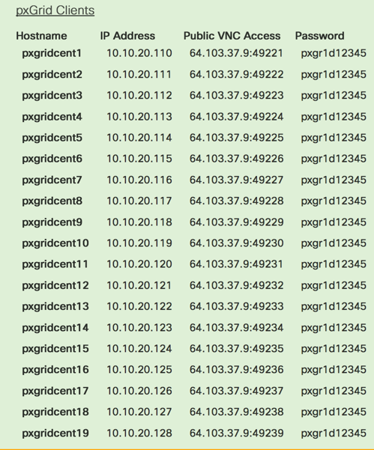

Lab Connection Information
Using the VNC client connect to one of the available PODS:
ISE Connection :

Slide 17
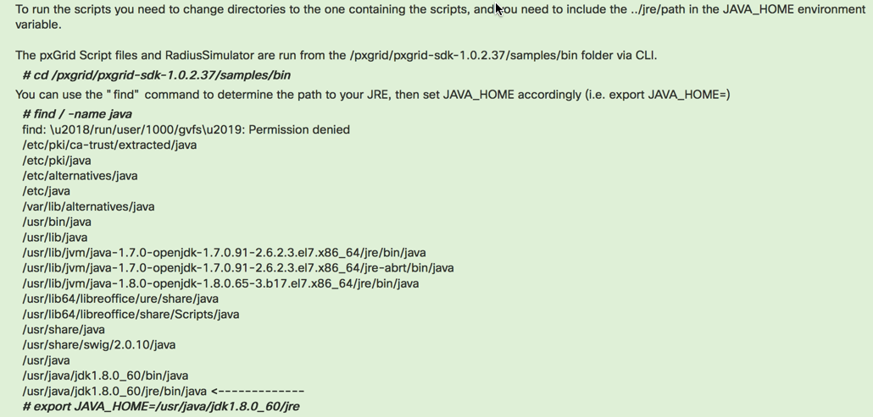
Programming Environment
When running these lab exercises, Substitute the client names and topic name to refer to the pxGrid client number. As an example, sdk01,auction01 refers to the pxGrid client 1 or pxGridcent1 and sdk02, auction02 refers to pxGrid client 2, or pxGridcent2, and so on.

